Slide 1


Interact (and bigInteract) tracks in the UCSC browser
Kate Rosenbloom
October 2018

Slide 2
Motivation
Show long-range pairwise interactions/relationships
Support cross-chromosome as well as same chromosome interactions
Handle multiple data types:
  Regulatory elements (e.g. SNP/gene)
  Chromatin interactions (e.g. chiaPet)
  Genomic rearrangements

Slide 3
Interact track features
Curved connectors represent interactions with both endpoints on-screen. Curve type is configurable (bezier, ellipse)
Dashed lines represent reverse direction
Mouseover and click-through on endpoints and ‘peaks’ (with glyph)
Vertical in lower band represents off-chromosome interaction. Labeled if space permits
User-colored or grayscale coloring

Slide 4
Example: GTEx trans-eQTLs
50 Mbp region of chromosome 3 where GTEx analysis identifies 15 significant long-distance eQTLs spanning the region, one variant affecting expression of a gene on another chromosome (F2RL3 on chromosome 19) and two genes (EDEM1 and LSMEM2) affected by variants on other chromosomes. Interactions are colored to indicate tissue.

Slide 5
Example: chiaPET chromatin interactions
16 ChiaPet chromatin interactions identified in a 640 Kbp region of chromosome 3 in the MCF7 cell line (courtesy Genome Institute of Singapore). Interactions are displayed in gray-scale, with stronger interactions shown darker.

Slide 6
First native interact track (just released): Genehancer
GeneHancer: genome-wide integration of enhancers and target genes in GeneCards
Contributors: Simon Fishelivich and Marilyn Safran, Genecards group, Weizmann Institute
GeneHancer is a database of human regulatory elements (enhancers and promoters) and their inferred target genes, which is embedded in GeneCards, a human gene compendium. The GeneHancer database was created by integrating >1 million regulatory elements from multiple genome-wide databases. Associations between the regulatory elements and target genes were based on multiple sources of linking molecular data, along with distance.
https://genome-test.gi.ucsc.edu/cgi-bin/hgTracks?hgS_doOtherUser=submit&hgS_otherUserName=Kate&hgS_otherUserSessionName=GeneHancer%20demo%20session

Slide 7
Interact track feature enhancements (Oct 2018)
1) New pack (and squish) visibilities and improved dense visibility,
using linked feature display with endpoint labels
Pack visibility resolves overlapping items
Compare to full visibility (black where colors overlap)

Slide 8
Interact track feature enhancements, cont.
2) Cluster view, groups items by source or target. Activated by track setting.
Interactions grouped by target, in pack mode
Compare to single interaction view in pack mode

Slide 9
Interact track feature enhancements, cont.
3) Inverted display. Activated by track setting.
Inverted display (“hills”)
Compare to default display (“valleys”)

Slide 10
Interact track feature enhancements, cont.
4) Offset source or target to separate visually. Activated by track setting.
offsetTarget
In this example, the regulatory elements (sources) are shown immediately below the track title, and the gene TSS (target) are shown on a horizontal some pixels lower in the image.
(The interaction track follows BED tracks of the regulatory elements and genes).

Slide 11
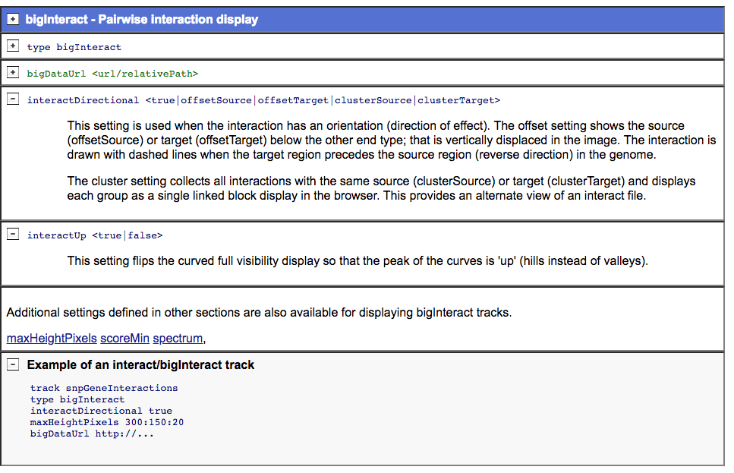
Interact track settings

Slide 12
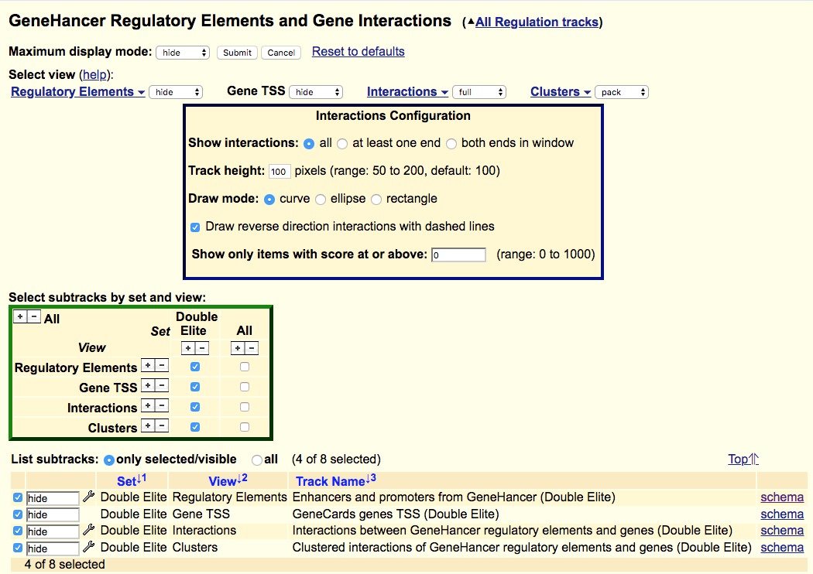
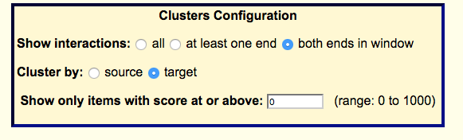

Slide 13
GeneHancer trackDb
Single interactions
Grouped interactions (“cluster view”)
track ghInteraction
shortLabel Interactions
type bigInteract
interactDirectional offsetTarget
view c_I
viewUi on
maxHeightPixels 50:100:200
url https://www.genecards.org/cgi-bin/carddisp.pl?
gene=$<geneName>
&keywords=$<geneHancerIdentifier>
&prefilter=enhancers#enhancers
urlLabel Interaction in GeneCards
visibility full
parent geneHancer
track geneHancerInteractions
shortLabel GH Interactions
longLabel Interactions between GeneHancer regulatory elements and genes
bigDataUrl /gbdb/$D/geneHancer/geneHancerInteractionsAll.$D.bb
urlLabel Interaction in GeneCards
parent ghInteraction off
subGroups set=b_ALL view=c_I
track ghClusteredInteraction
shortLabel Clustered Interactions
type bigInteract
interactDirectional clusterTarget
view d_I
url https://www.genecards.org/cgi-bin/carddisp.pl? gene=$<geneName>&keywords=
$<geneHancerIdentifier>
&prefilter=enhancers#enhancers
urlLabel Interaction in GeneCards
visibility pack
parent geneHancer
track geneHancerClusteredInteractions
shortLabel GH Clusters
longLabel Clustered interactions of GeneHancer regulatory elements and genes
bigDataUrl /gbdb/$D/geneHancer/geneHancerInteractionsAll.$D.bb
urlLabel Interaction in GeneCards
parent ghClusteredInteraction off
subGroups set=b_ALL view=d_I

Slide 14
Implementation
Based on longTabix track type
  Extended drawing modes (curves, dashed)
  New schema to support more display and data mining features, and more standard BED layout. (vs. WashU+Ensembl schema used in longTabix).
  Additional enhancements: e.g. cross-chrom item layout, endpoint and peak mouseovers, pack mode, cluster view, inverted display
Implemented for native tracks, custom tracks, and hubs

Slide 15
longTabix track type
#chrom chromStart chromEnd interactingRegion id strand
chr1 117602428 117606376 chr1:117608302-117612634,5 2155 +
chr1 117608302 117612634 chr1:117602428-117606376,5 2156 -
Format created at Wash U (“LongRange”). Somewhat extended by Ensembl:
http://wiki.wubrowse.org/Long
https://uswest.ensembl.org/info/website/upload/pairwise.html
Not documented at UCSC. Requires 2 rows/interaction. Interactions disappear when zoomed in, etc. -> Superceded by interact

Slide 16
Interact schema
% cat interact.as
table interact
"Interaction between two regions"
(
string chrom; "Chromosome (or contig, scaffold, etc.). For interchromosomal, use 2 records"
uint chromStart; "Start position in chromosome of lower region.
For interchromosomal, set to chromStart of this region"
uint chromEnd; "End position in chromosome of upper region.
For interchromosomal, set to chromEnd of this region"
string name; "Name of item, for display. Usually 'name1/name2' or empty"
uint score; "Score from 0-1000.”
double value; "Strength of interaction or other data value. Typically basis for score"
string exp; "Experiment name (metadata for filtering). Use . if not applicable"
uint color; "Item color, as itemRgb in bed9. Typically based on strength or filter"
string sourceChrom; "Chromosome of source region (directional) or lower region.
For non-directional interchromosomal, chrom of this region."
uint sourceStart; "Start position in chromosome of source/lower/this region"
uint sourceEnd; "End position in chromosome of source/lower/this region"
string sourceName; "Identifier of source/lower/this region. Can be used as link to related table"
string sourceStrand; "Orientation of source/lower/this region: + or -. Use . if not applicable"
string targetChrom; "Chromosome of target region (directional) or upper region.
For non-directional interchromosomal, chrom of other region"
uint targetStart; "Start position in chromosome of target/upper/this region"
uint targetEnd; "End position in chromosome of target/upper/this region"
string targetName; "Identifier of target/upper/this region. Can be used as link to related table"
string targetStrand; "Orientation of target/upper/this region: + or -. Use . if not applicable"
)
NOTE: BigInteract usres are strongly encouraged to rename and describe fields to fit their data

Slide 17
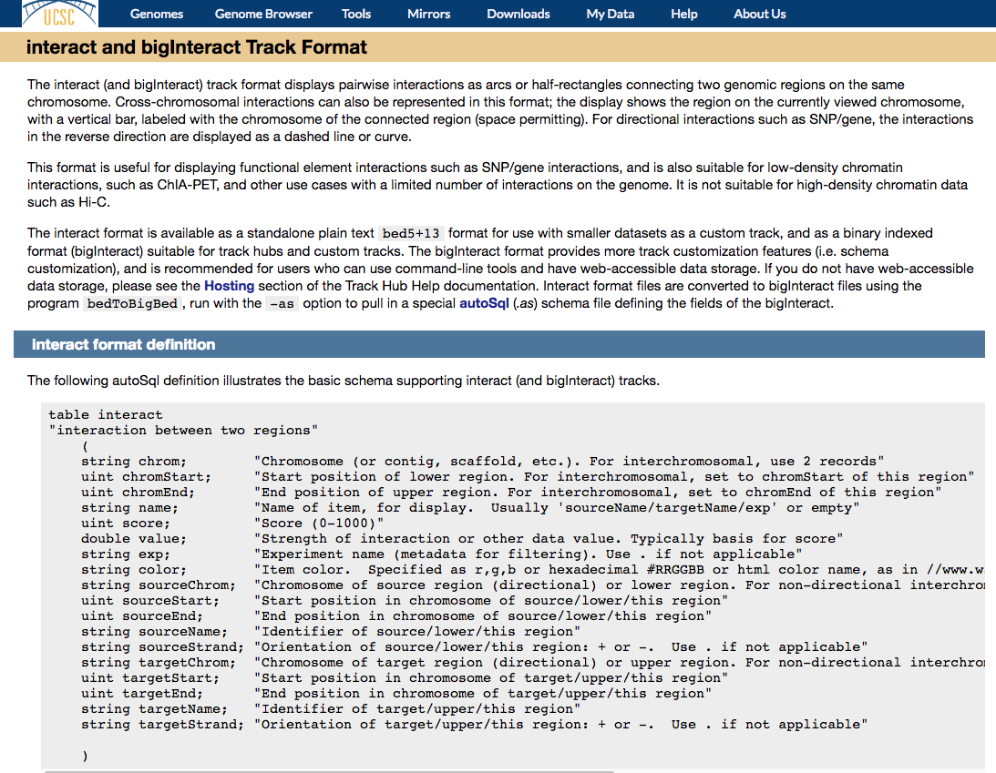
Documentation
http://genome.ucsc.edu/goldenPath/help/interact.html

Slide 18
Create your own interact track
Custom Track file with 4 interactions:
track type=interact visibility=full
# Interact Source Target
# chrom start end name score value exp color chrom start end name strand chrom start end name strand
chr6 99790007 99798261 inter1 233 4.0 brain 255,0,0 chr6 99790007 99793559 rs1 . chr6 99794572 99798261 gene1 +
chr6 99797231 99875440 inter2 175 3.2 blood 0,255,0 chr6 99797231 99801068 rs2 . chr6 99873105 99875440 gene2 +
chr6 99834530 99843149 inter3 175 3.1 liver 0,0,255 chr6 99834530 99837680 rs3 . chr6 99839323 99843149 gene3 -
chr6 99848067 99857519 inter4 175 3.5 kidney 0 chr6 99848067 99852034 rs4 . chr6 99855098 99857519 gene4 +
First data row: Track line: track type=interact visibility=full
description=“Interact track example“
chr6 # chrom
99790007 # start
99798261 # end Browser image:
inter1 # name
233 # score
4.0 # value
brain # exp
255,0,0 # color
chr6 # sourceChrom
99790007 # sourceStart
99793559 # sourceEnd
rs1 # sourceName
. # sourceStrand
chr6 # targetChrom
99794572 # targetStart Format as bigInteract track, for a track hub
99798261 # targetEnd
gene1 # targetName bedToBigBed –tab –type=bed5+13 –as=interact.as
+ # targetStrand myData.inter.bed chrom.sizes myData.inter.bigBed

Slide 19
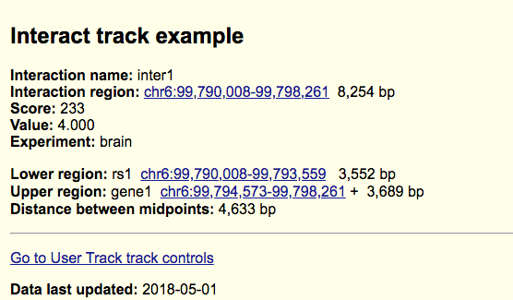
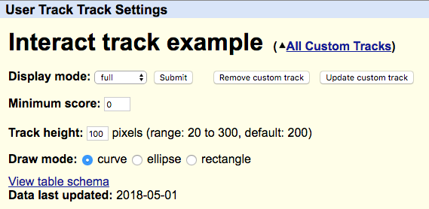
Details page
Configuration page
NOTE: this is missing new options (see previous slide ☺

Slide 20
Many thanks!
Jim, Max and Braney for design input
Braney for engineering guidance through longTabix land
Jairo and Lou for quality review
And others who I have inadvertently omitted ;-(

