Slide 1

VGP project annotations in the UCSC Genome Browser
18 October 2024 – Hiram Clawson
U.C. Santa Cruz Genomics Institute
this presentation: https://bit.ly/3BMeteB
Notes:
Presentation at the VGP meeting call Friday 18 October 2024.

Slide 2
1. UCSC Genome Browser
2. Finding an assembly
3. Example GTF gene track
4. Saved session to share view
Topics today:
Notes:
Presentation at the VGP meeting call Friday 18 October 2024.

Slide 3
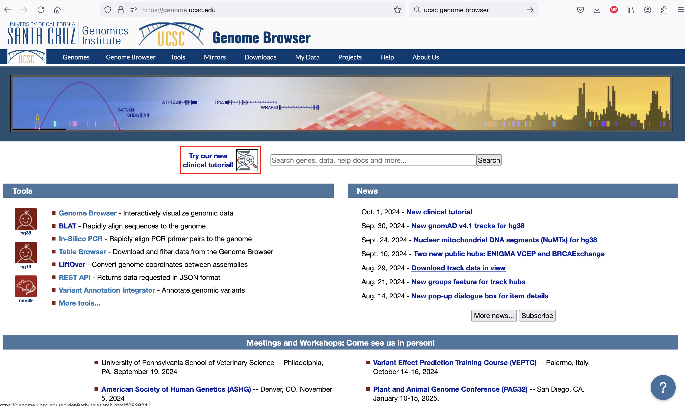
genome.ucsc.edu
Notes:
Merely a home page for google indexing. Most users do not interact with this page. Use the ‘Genomes’ to get to the ‘gateway’ page. https://genome.ucsc.edu/

Slide 4
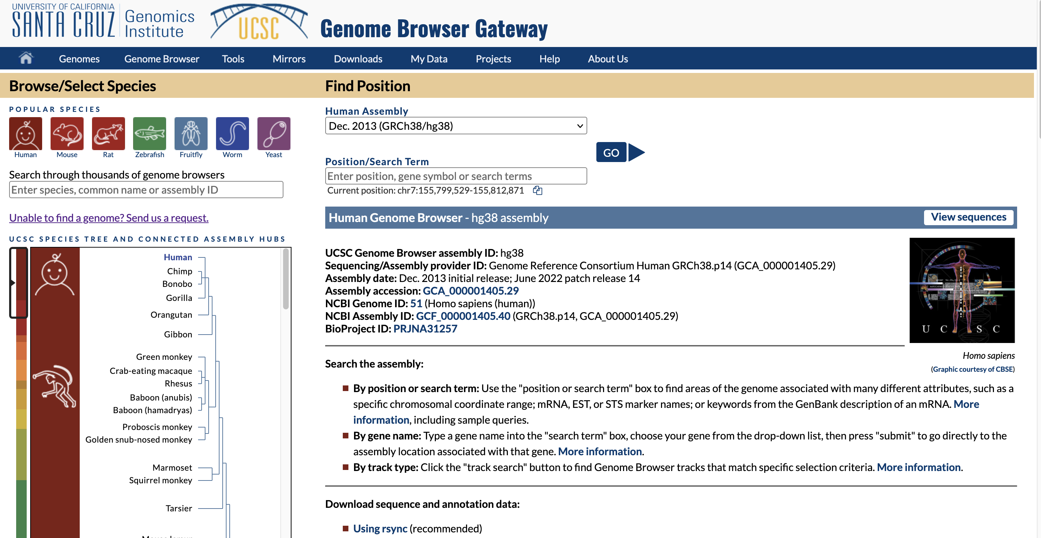
“gateway” page - genome.ucsc.edu/cgi-bin/hgGateway
FIND ASSEMBLY
Notes:
The ‘gateway’ page is where you can find and select an assembly for display. https://genome.ucsc.edu/cgi-bin/hgGateway

Slide 5
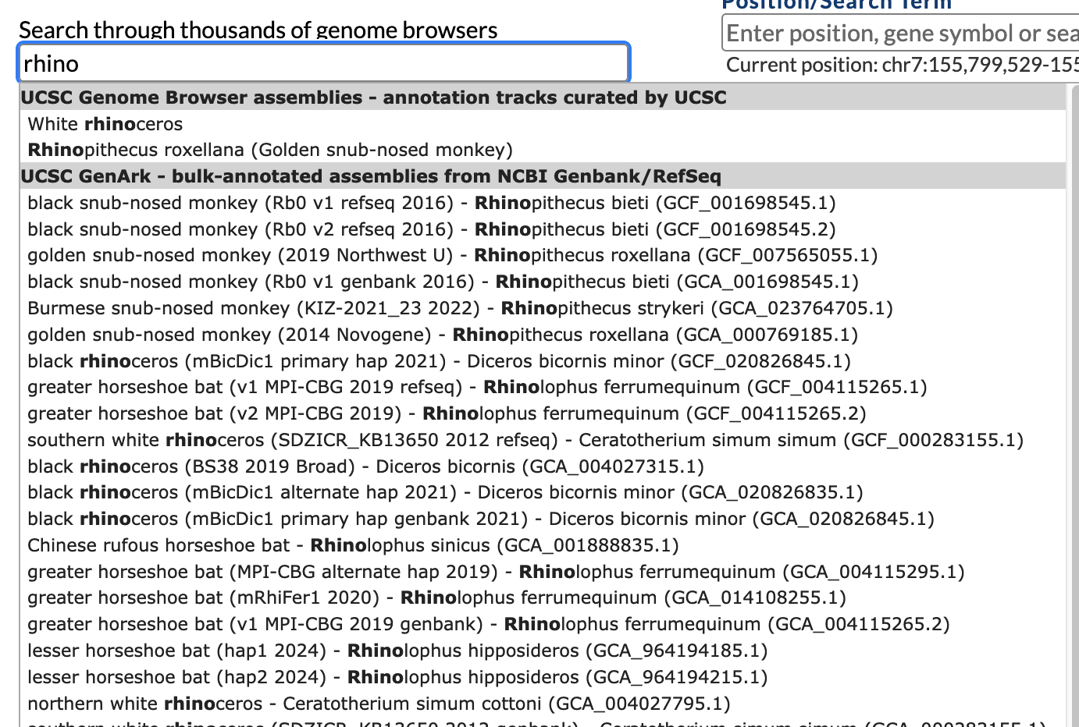
single word search can be prefix search:
Notes:
This search procedure has recently been improved. Enter search word(s) in the gateway page search form. Single words that do not have a match will be matched as a prefix.

Slide 6
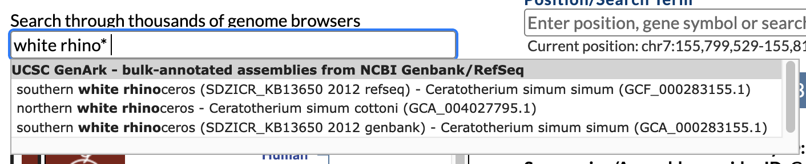
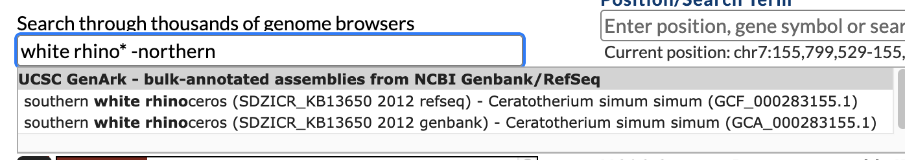
multiple word searches can be revealing
Notes:
Multiple word searches have a variety of hidden options, we have not yet documented this new feature. A word with star* suffix will be a prefix search, a word preceded with –minus sign means to *not* include such matches in the result.

Slide 7
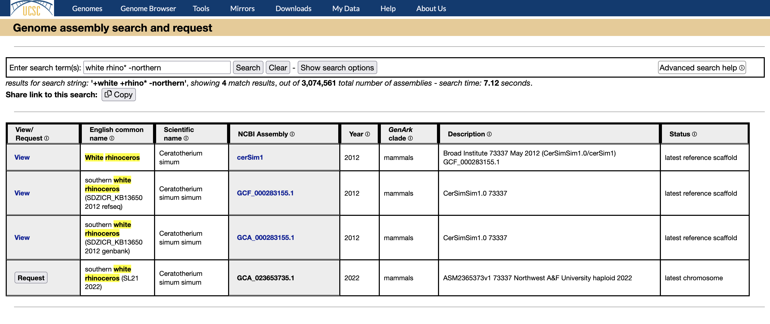
Unannounced new feature: https://genome.ucsc.edu/assemblySearch.html
Notes:
This recent function is under testing at this time, has not yet been announced or linked into our documentation. Note the extra search options and information about how to use the advanced search string features. https://genome.ucsc.edu/assemblySearch.html

Slide 8
A ‘track hub’ is a set of files you prepare and host on a web server such as the
‘Genome Ark’
Example track using the ‘track hub’ process:
Example here will show the processing of a GTF gene definition file into a ‘bigBed’ file for use in the browser
Notes:
Track hubs are used in the genome browser to display data tracks on a genome assembly. The files in a track hub must be available at a URL for the genome browser to use the files.

Slide 9
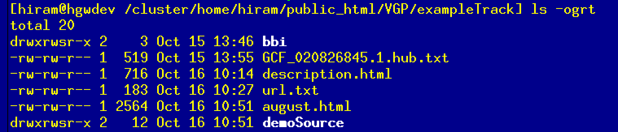
A ‘track hub’ is a set of files you create and maintain with your annotation data,
available via a URL for access to the genome browser:
https://genome-test.gi.ucsc.edu/~hiram/VGP/exampleTrack/
Notes:
Example directory shows the hub.txt file and html documentation files that are referenced in the hub.txt file. The bbi/ directory contains the data file for the track, and the demoSource directory here shows the processing example. Access this example: https://genome-test.gi.ucsc.edu/~hiram/VGP/exampleTrack/

Slide 10
hub annotation demonstration shortLabel demo gene track longLabel demonstration gene track on black rhinoceros (mBicDic1 primary hap 2021)/Diceros bicornis minor/GCF_020826845.1_mDicBic1.mat.cur useOneFile on email hclawson@ucsc.edu descriptionUrl description.html genome GCF_020826845.1 track august shortLabel Augustus demonstration longLabel demonstration Augustus Gene Predictions visibility pack color 180,0,0 type bigGenePred bigDataUrl bbi/GCF_020826845.1.augustus.bb html august
The ‘hub.txt’ file defines your data for the genome browser
genome-test.gi.ucsc.edu/~hiram/VGP/exampleTrack/GCF_020826845.1.hub.txt
hub description
target assembly
track definition(s)
Notes:
The hub.txt is given to the genome browser to display your data track(s). Must use the GCx_012345678.9 accession name to reference a browser in the ‘GenArk’ collection. Important to have the ‘email’ for author contact, and the description.html for the hub description, and the august.html for the track definition. Access this hub.txt file: https://genome-test.gi.ucsc.edu/~hiram/VGP/exampleTrack/GCF_020826845.1.hub.txt

Slide 11
In this example, the processing is:
1. gtfToGenePred
2. genePredCheck
3. genePredToBigGenePred
4. bedToBigBed
5. bigBedInfo
genome-test.gi.ucsc.edu/~hiram/VGP/exampleTrack/demoSource/process.sh.txt
genome-test.gi.ucsc.edu/~hiram/VGP/exampleTrack/demoSource/makefile.txt
Notes:
Typical processing pipeline to create a ‘bigBed’ file for use by the genome browser to display this track data. Note the processing encapsulated in the process.sh shell script or in the makefile. https://genome-test.gi.ucsc.edu/~hiram/VGP/exampleTrack/demoSource/process.sh.txt
and https://genome-test.gi.ucsc.edu/~hiram/VGP/exampleTrack/demoSource/makefile.txt

Slide 12
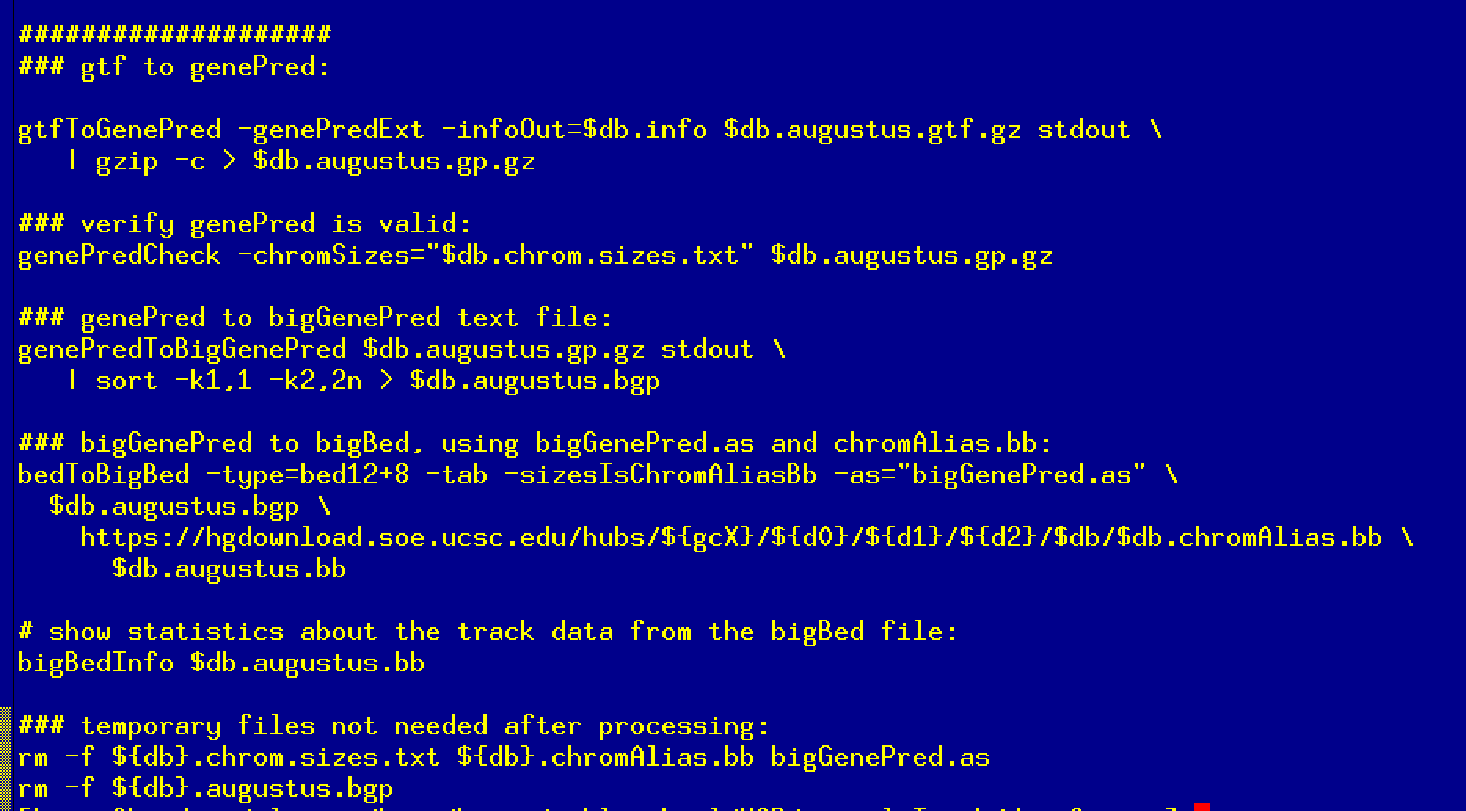
genome-test.gi.ucsc.edu/~hiram/VGP/exampleTrack/demoSource/process.sh.txt
genome-test.gi.ucsc.edu/~hiram/VGP/exampleTrack/demoSource/makefile.txt
Notes:
Typical processing pipeline to create a ‘bigBed’ file for use by the genome browser to display this track data. Note the processing encapsulated in the process.sh shell script or in the makefile. https://genome-test.gi.ucsc.edu/~hiram/VGP/exampleTrack/demoSource/process.sh.txt
and https://genome-test.gi.ucsc.edu/~hiram/VGP/exampleTrack/demoSource/makefile.txt

Slide 13
A single URL, broken into lines here to show the elements: https://genome.ucsc.edu/cgi-bin/hgTracks? genome=GCF_020826845.1& position=chrX:12720144-12811022& hubUrl=https://genome-test.gi.ucsc.edu/~hiram/VGP/exampleTrack/GCF_020826845.1.hub.txt
Attach your track hub.txt file to the genome browser:
Save the browser view in a ‘saved session’ to
have a short URL to share with collaborators.
.
https://genome.ucsc.edu/s/Hiram/VGP_trackHubExample
Notes:
There is a user interface form in the genome browser where you can enter the URL to your hub.txt. https://genome.ucsc.edu/s/Hiram/VGP_trackHubExample

Slide 14
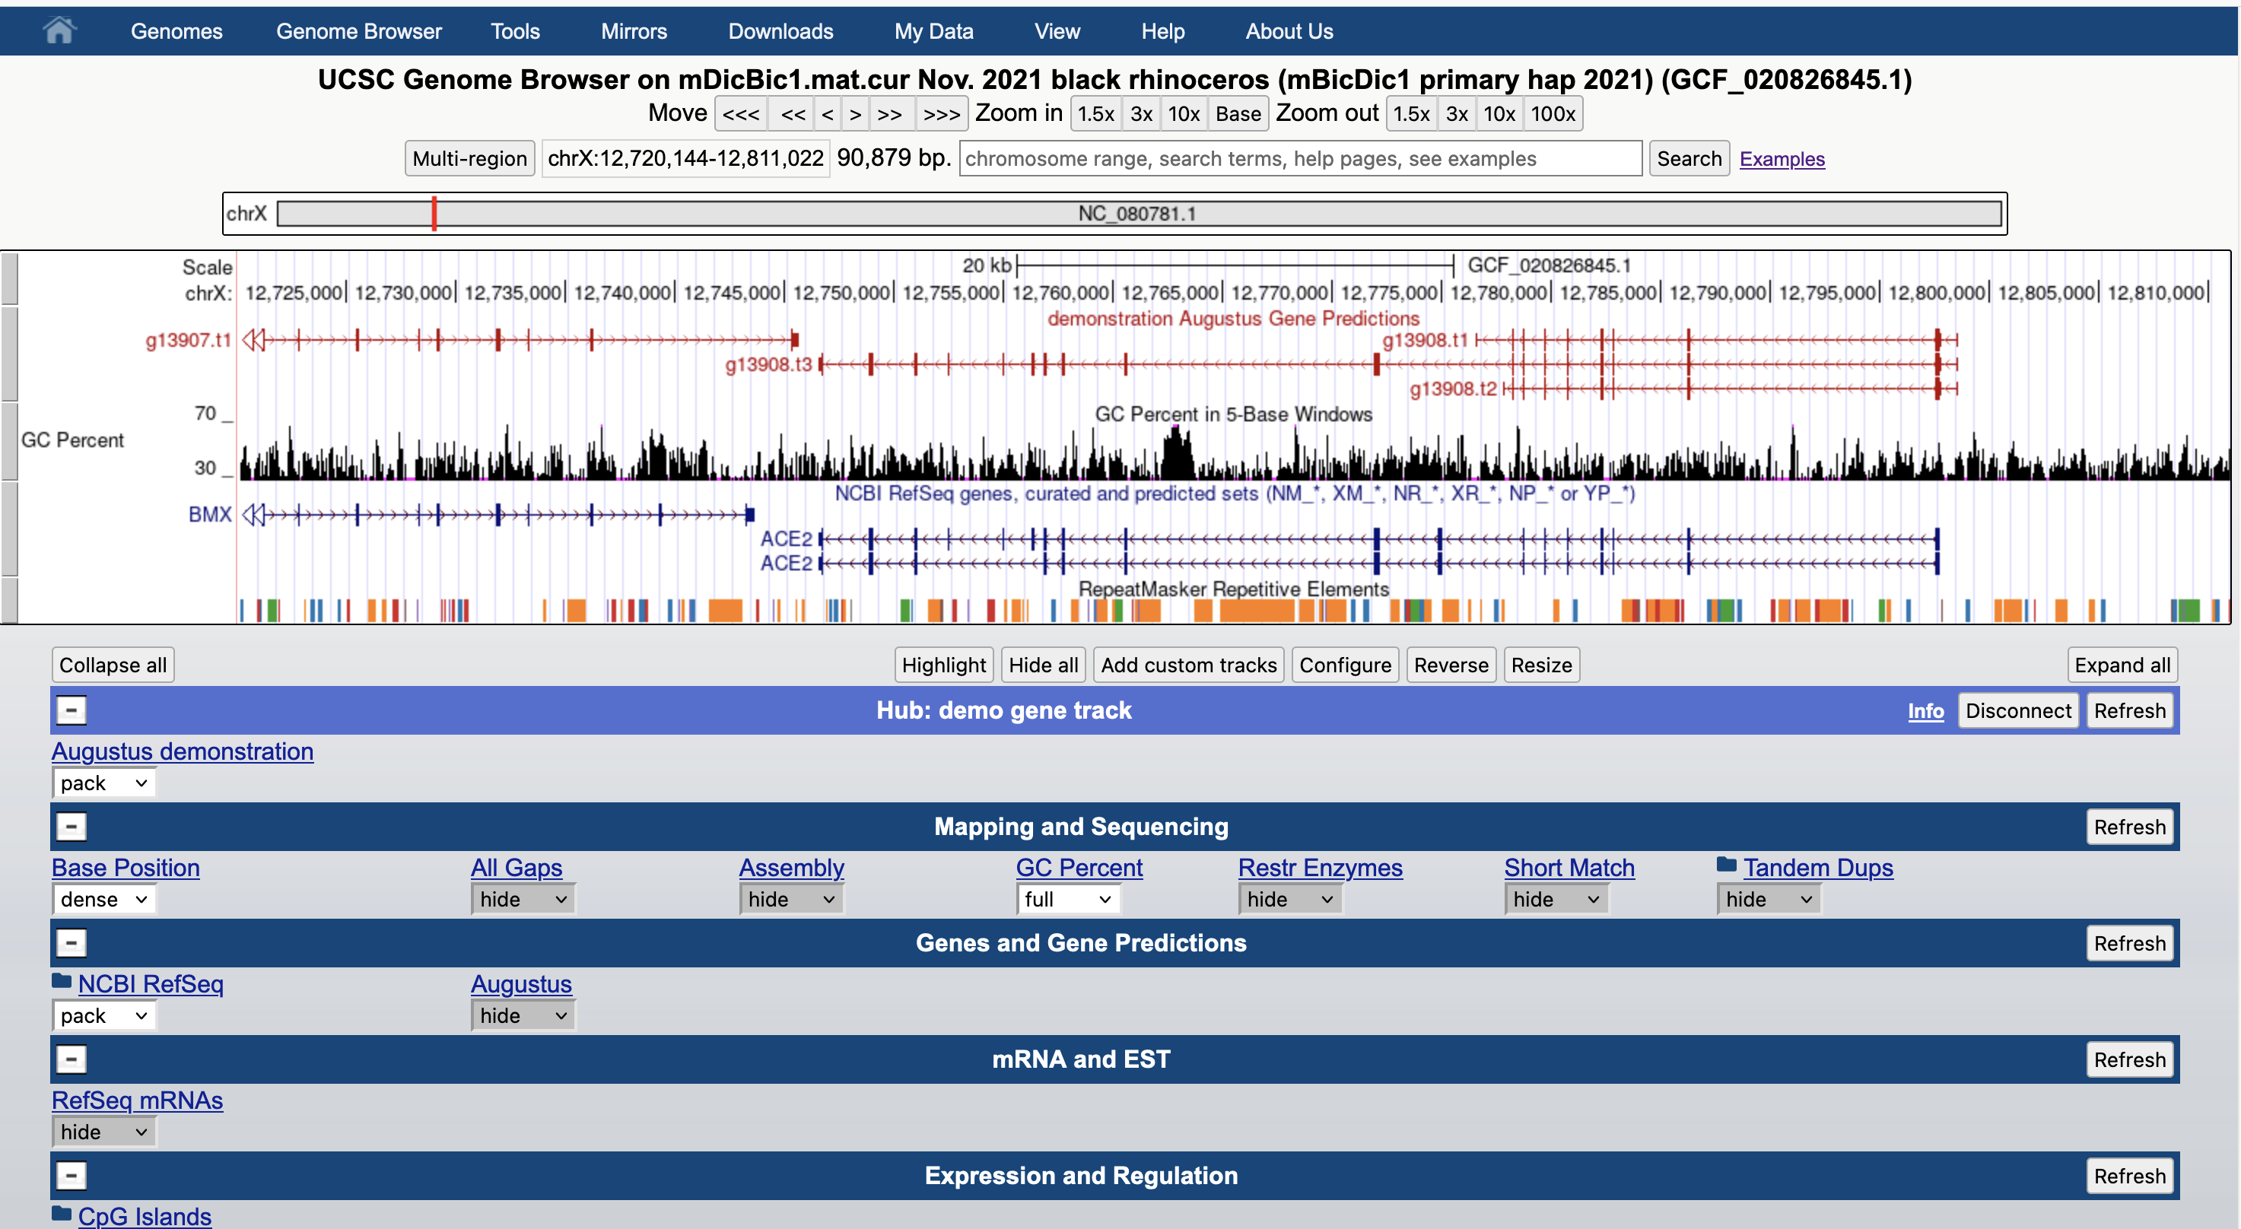
https://genome.ucsc.edu/s/Hiram/VGP_trackHubExample
.
Notes:
There is a user interface form in the genome browser where you can enter the URL to your hub.txt. https://genome.ucsc.edu/s/Hiram/VGP_trackHubExample

Slide 15
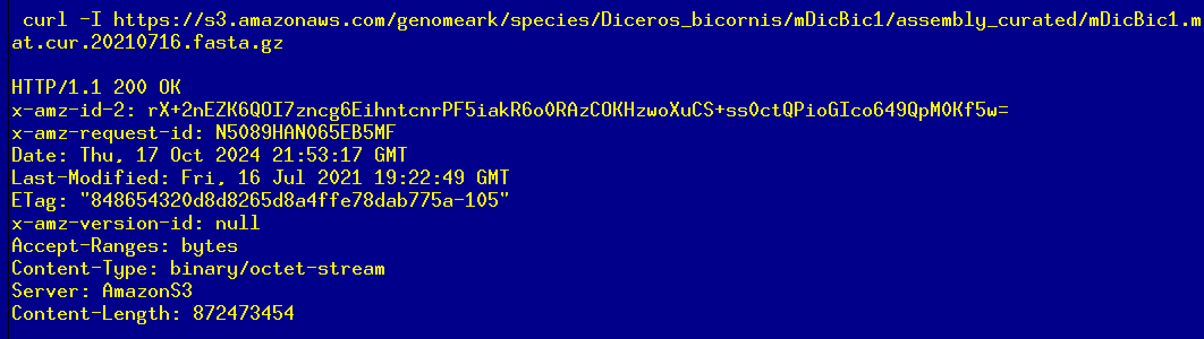
Web service must honor ‘byte-range’ requests for random access,
test with curl -I
Track hub development documentation, track types and options:
http://genome.ucsc.edu/goldenPath/help/trackDb/trackDbHub.html
Can use existing examples:
https://hgdownload.soe.ucsc.edu/hubs/GCF/020/826/845/GCF_020826845.1/hub.txt
Notes:
The web server must honor ‘byte-range’ requests for random access to the ‘bigBed’ binary files. Track hub documentation: http://genome.ucsc.edu/goldenPath/help/trackDb/trackDbHub.html, example: https://hgdownload.soe.ucsc.edu/hubs/GCF/020/826/845/GCF_020826845.1/hub.txt

Slide 16
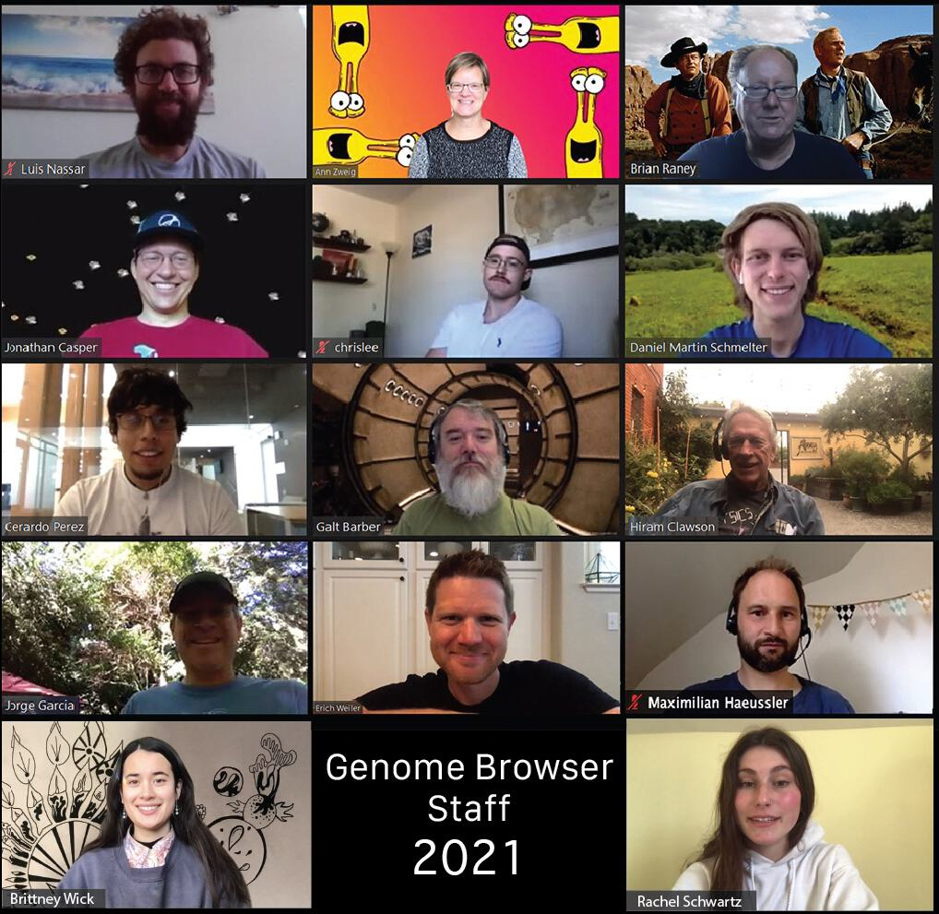
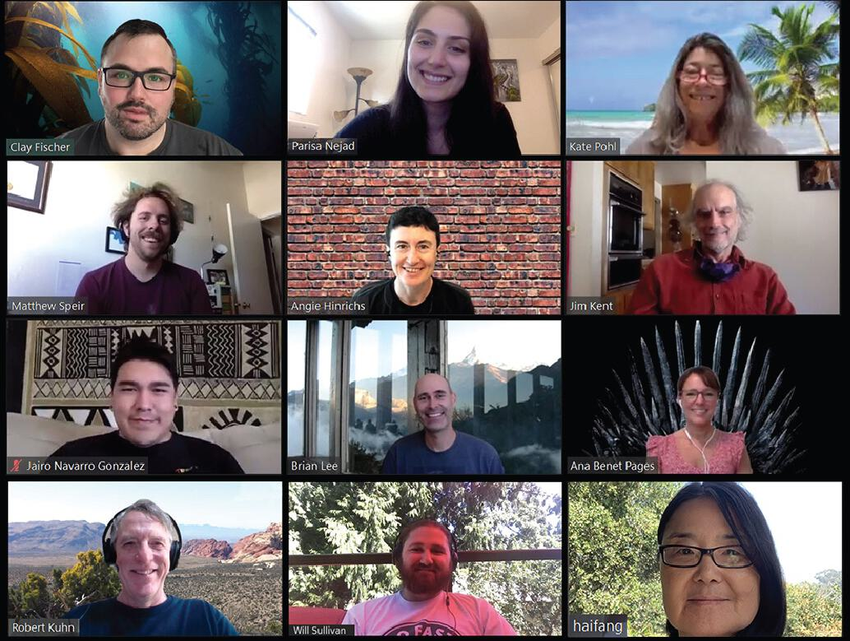
The UCSC Genome Browser Staff

