Slide 1

BME-110 – Computational Biology Tools
Thursday 22 January 2026 – Kresge Academic 3201
Hiram Clawson – U.C. Santa Cruz Genomics Institute
software engineer on the genome browser project:
https://genome.ucsc.edu/
Private email to the browser staff: genome-www@soe.ucsc.edu
Public email list: genome@soe.ucsc.edu
Latest updated copy of this presentation: https://bit.ly/4pP3jZR
Notes:
Hiram Clawson – hclawson@ucsc.edu - https://www.linkedin.com/in/hiram-clawson-46448b/ - browser staff private email: genome-www@soe.ucsc.edu – public email list: genome@soe.ucsc.edu Latest copy of this presentation: https://bit.ly/4jr3pVt

Slide 2
Today’s topics
1. The genome browser: https://genome.ucsc.edu/ brief introduction
2. Browser educational resources: https://genome.ucsc.edu/training/education/
interactive browser sessions demonstrating biology topics
3. Leave you with a puzzle: what is CODIS ?
Some fun links for your entertainment:
1. https://youtu.be/0fKBhvDjuy0/ - Powers of 10 (1977) Eames office
2. https://youtu.be/7Hk9jct2ozY/ - DNA animation (2002-2014) by Drew Berry and Etsuko Uno
3. https://youtu.be/ydqReeTV_vk/ - Evo Devo (biology) – Acapella Science
4. https://youtu.be/f8FAJXPBdOg/ - The Molecular Shape of You (quantum atomic theory) – Acapella Science
5. https://youtu.be/SKhcan8pk2w/ - Homochirality (all natural sugar is ‘right’ handed) – Steve Mould
https://youtu.be/b34al8YmQSA/ - All coal is the same age (really ?) – Steve Mould
https://youtu.be/XX7PdJIGiCw/ - Simulating the History of Life – Veritasium
https://youtu.be/MiUHjLxm3V0/ – The world’s most important machine - Veritasium
Notes:
Overview of presentation. 1. The UCSC Genome Browser 2. Educational resources in the Genome Browser. 3. What is CODIS. Fun links: 1. https://youtu.be/0fKBhvDjuy0 2. https://youtu.be/7Hk9jct2ozY 3, https://youtu.be/ydqReeTV_vk 4. https://youtu.be/f8FAJXPBdOg 5. https://youtu.be/SKhcan8pk2w 6. https://youtu.be/b34al8YmQSA

Slide 3
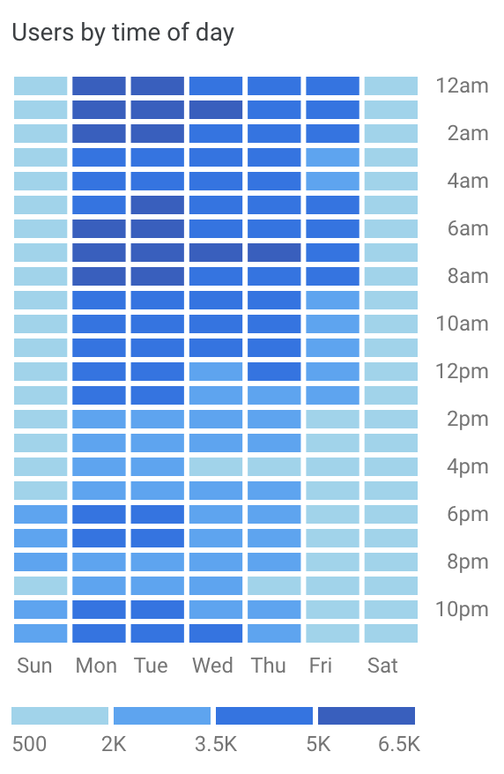
The UCSC Genome Browser
2002 - https://pubmed.ncbi.nlm.nih.gov/19957273/
Providing a web browser view of the human genome since 2001, added mouse genome in 2002, today serving up a view of nearly 50,000 genome assemblies for over 40,000 species
15,000 users per day, web site 300,000+ data files == 23 Tb of data, 59,000+ MySQL tables == 7 Tb of data, 90 Tb data available for download (over 2 Tb per day is sent out)
Live demonstration: https://genome.ucsc.edu/
Notes:
Original paper describing the genome browser: https://pubmed.ncbi.nlm.nih.giv/19957273/

Slide 4
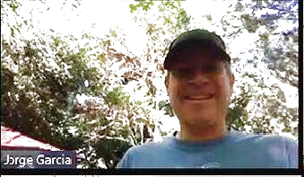
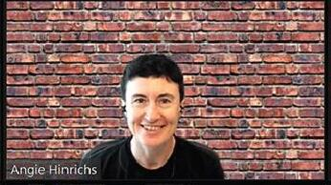
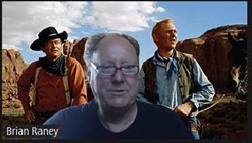
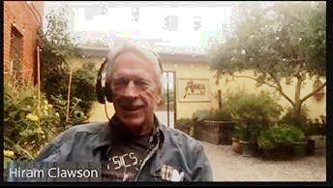
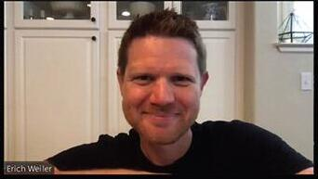
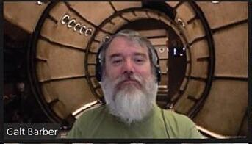
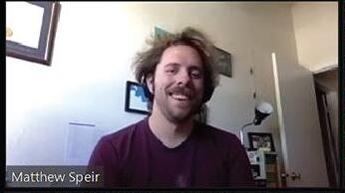
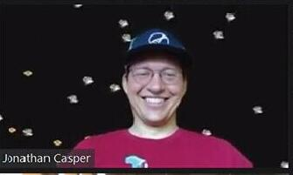
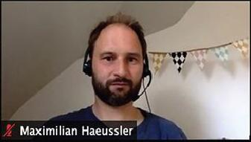
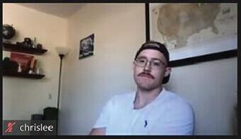
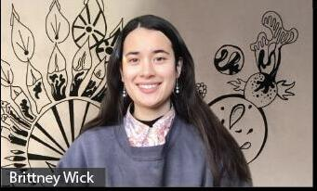
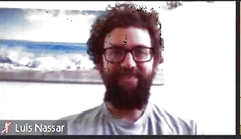
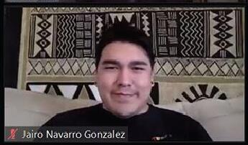
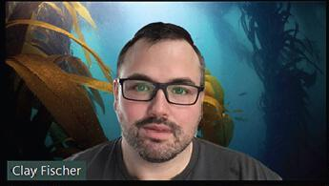
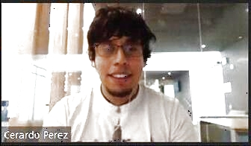
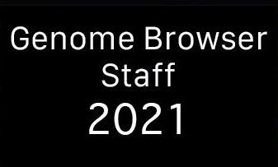
UCSC Genome Browser Staff 2026
Jorge
Angie
Brian
Hiram
Erich
Galt
Matt
Jonathan
Max
Chris
Brittney
Lou
2026
Jairo
Clay
Gerardo
2026
Notes:
The UCSC browser staff 2026.

Slide 5
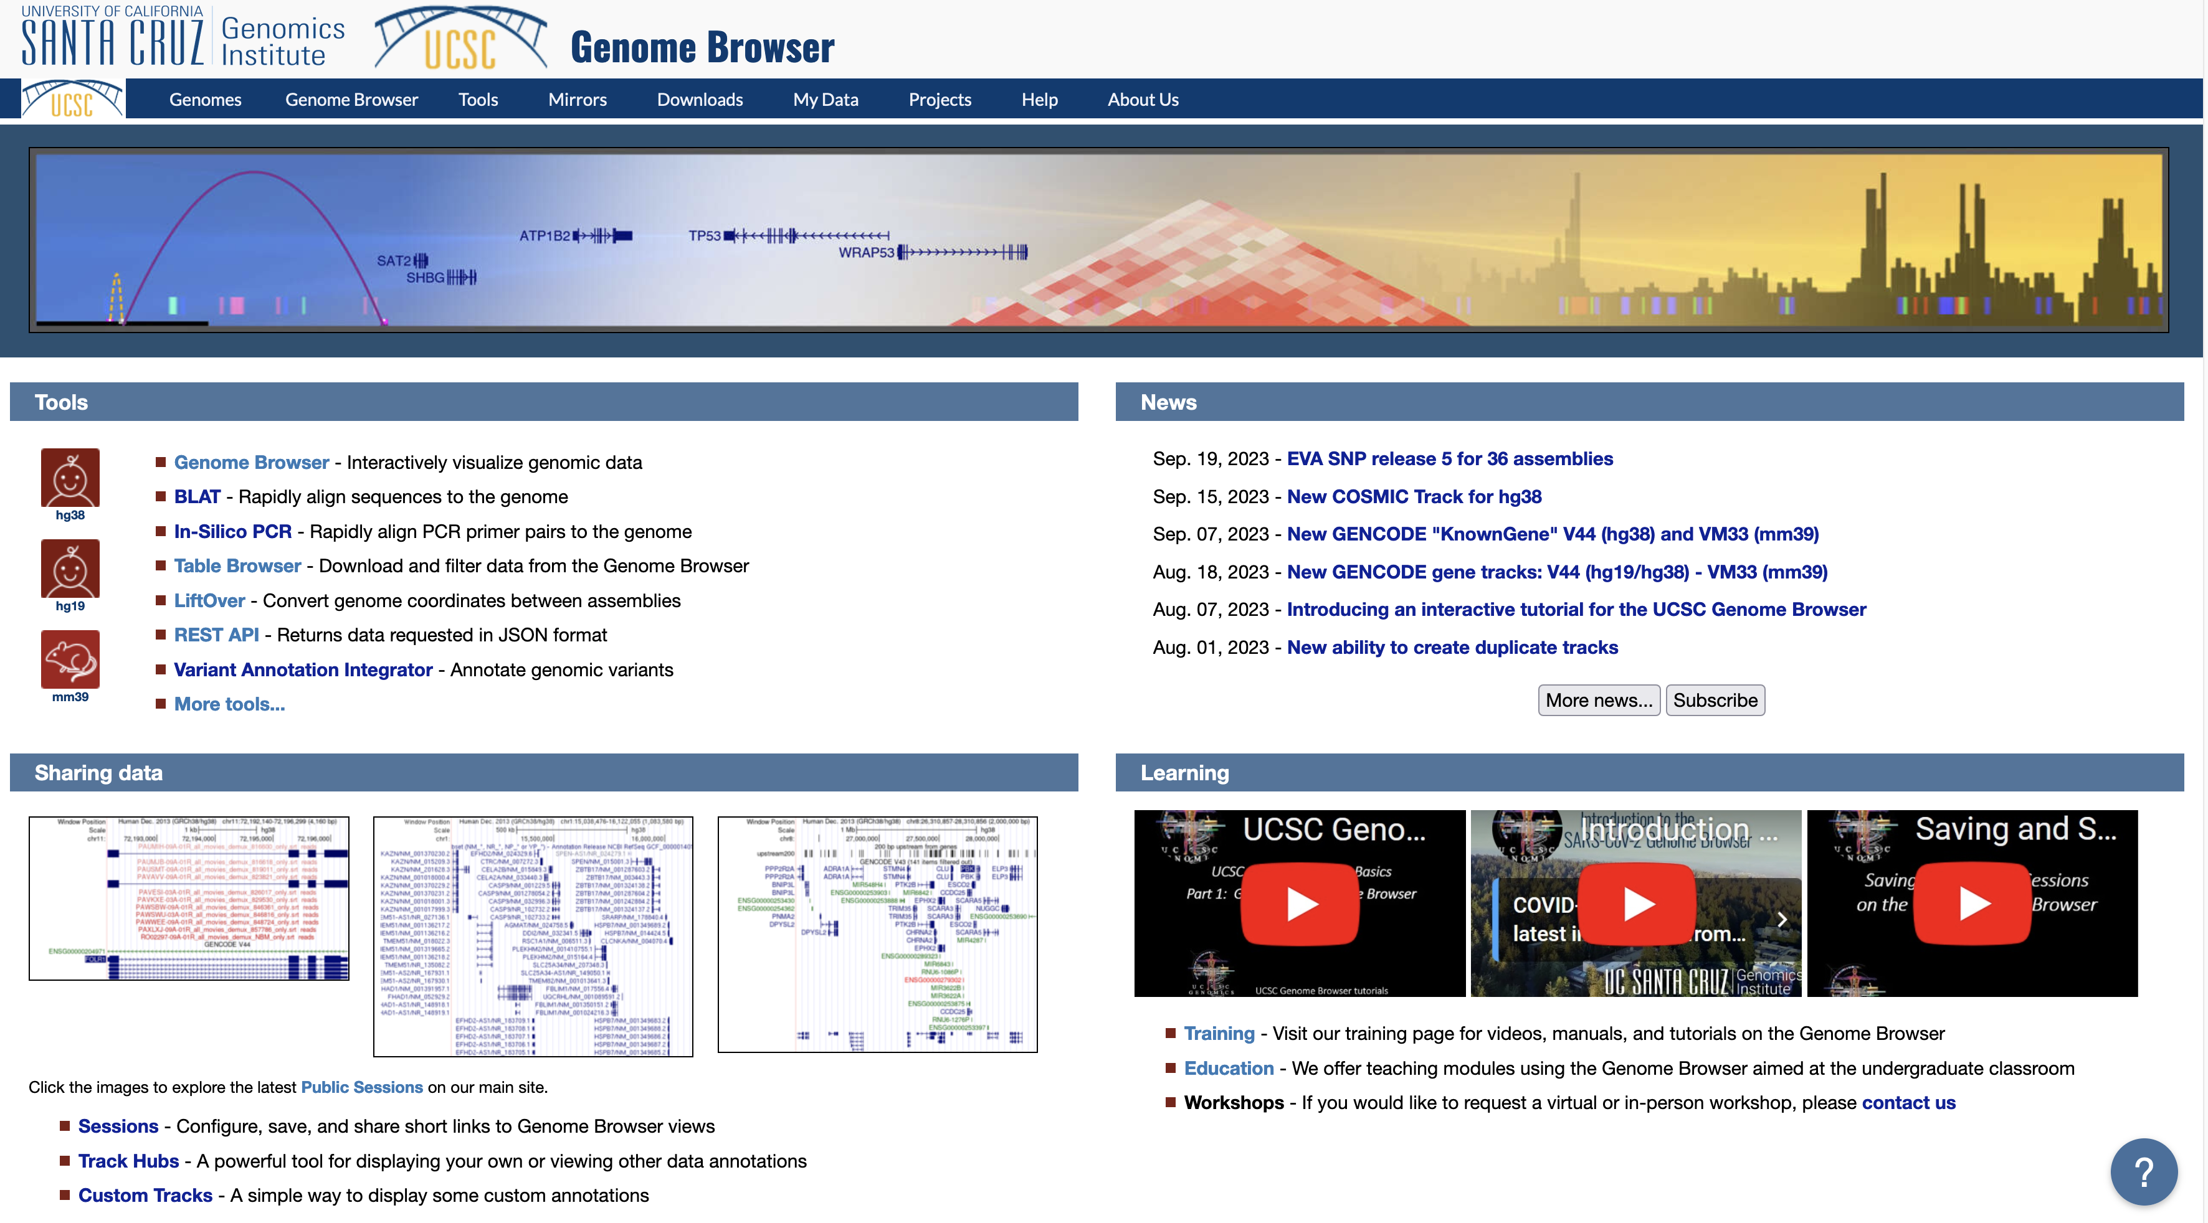
https://genome.ucsc.edu/ browser ‘home’ page
Use the blue
navigation bar
Click on ‘Genomes’ to get to the ‘gateway’ page
Notes:
The Genome Browser ‘home’ page – https://genome.ucsc.edu/ - click on the ‘Genomes’ link to get to the ‘gateway’ page. Best ti use the blue navigation bar to move around in the browser environment. Browser ‘back’ buttons are not always easy to process.

Slide 6
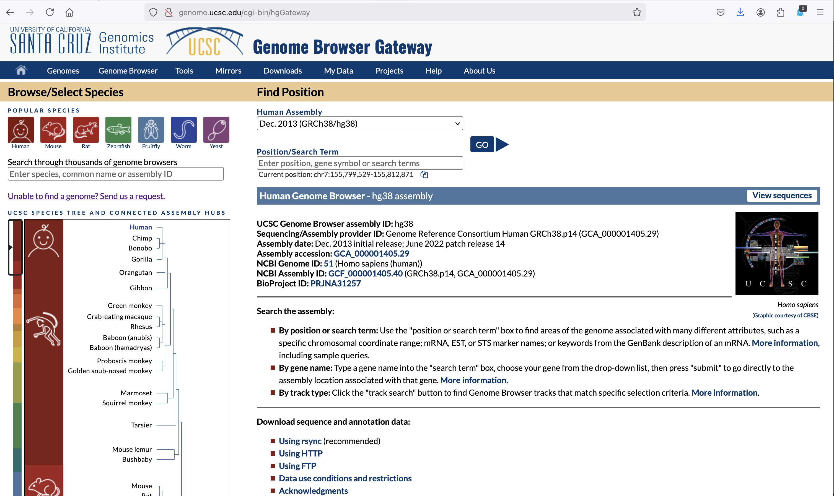
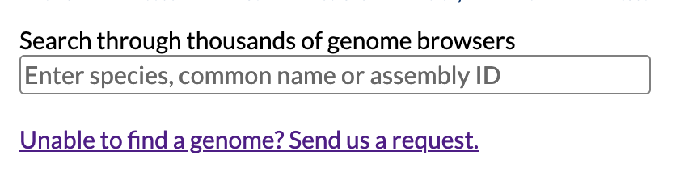
https://genome.ucsc.edu/cgi-bin/hgGateway ‘gateway’ page
Note the search
form entry
Text search, any
word, case
insensitive
Notes:
The Genome Browser ‘gateway’ page – https://genome.ucsc.edu/cgi-bin/hgGateway – select genome to view – after selected, press the ‘GO’ to view the genome in the browser

Slide 7
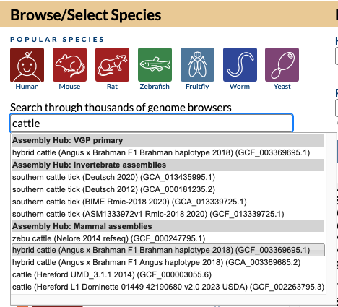
enter search term to find assembly
https://genome.ucsc.edu/cgi-bin/hgGateway
select the assembly to view from the list
Notes:
Enter a search term in the form, a pull-down menu will appear with assemblies matching your search term. Click on the assembly of interest.

Slide 8
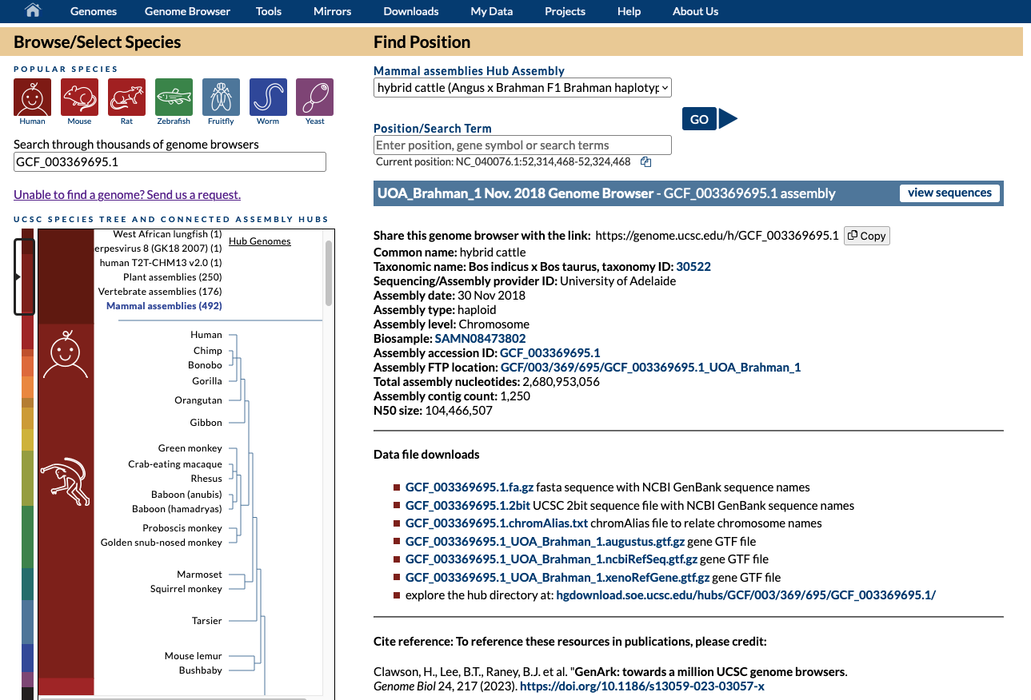
gateway page now shows your selected assembly
Notes:
After you select your assembly, it will appear on the gateway page. The ‘GO’ button goes to the genome browser display. The ‘view sequences’ button leads to a display of the names of sequences in this assembly

Slide 9
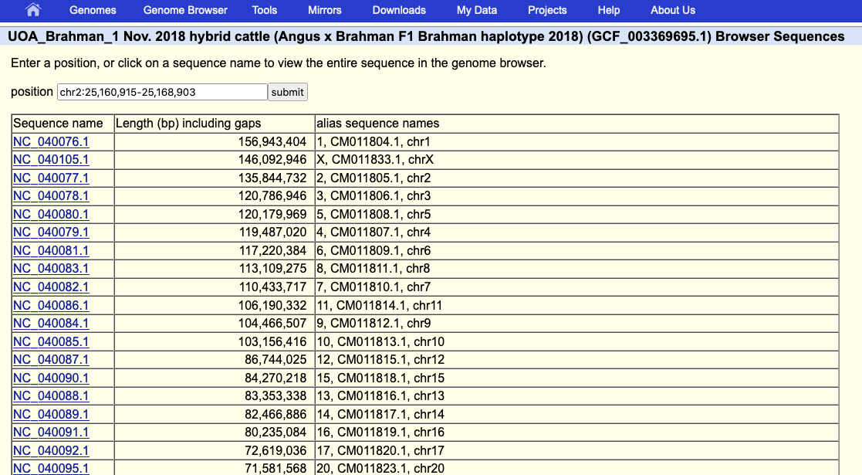
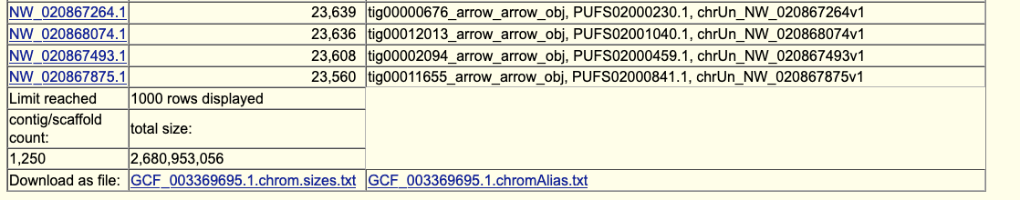
view sequences show names and aliases
Notes:
The ‘view sequences’ shows the names of the sequences in the assembly and the alternative ‘alias’ names that can be used for custom track data display on this assembly.

Slide 10
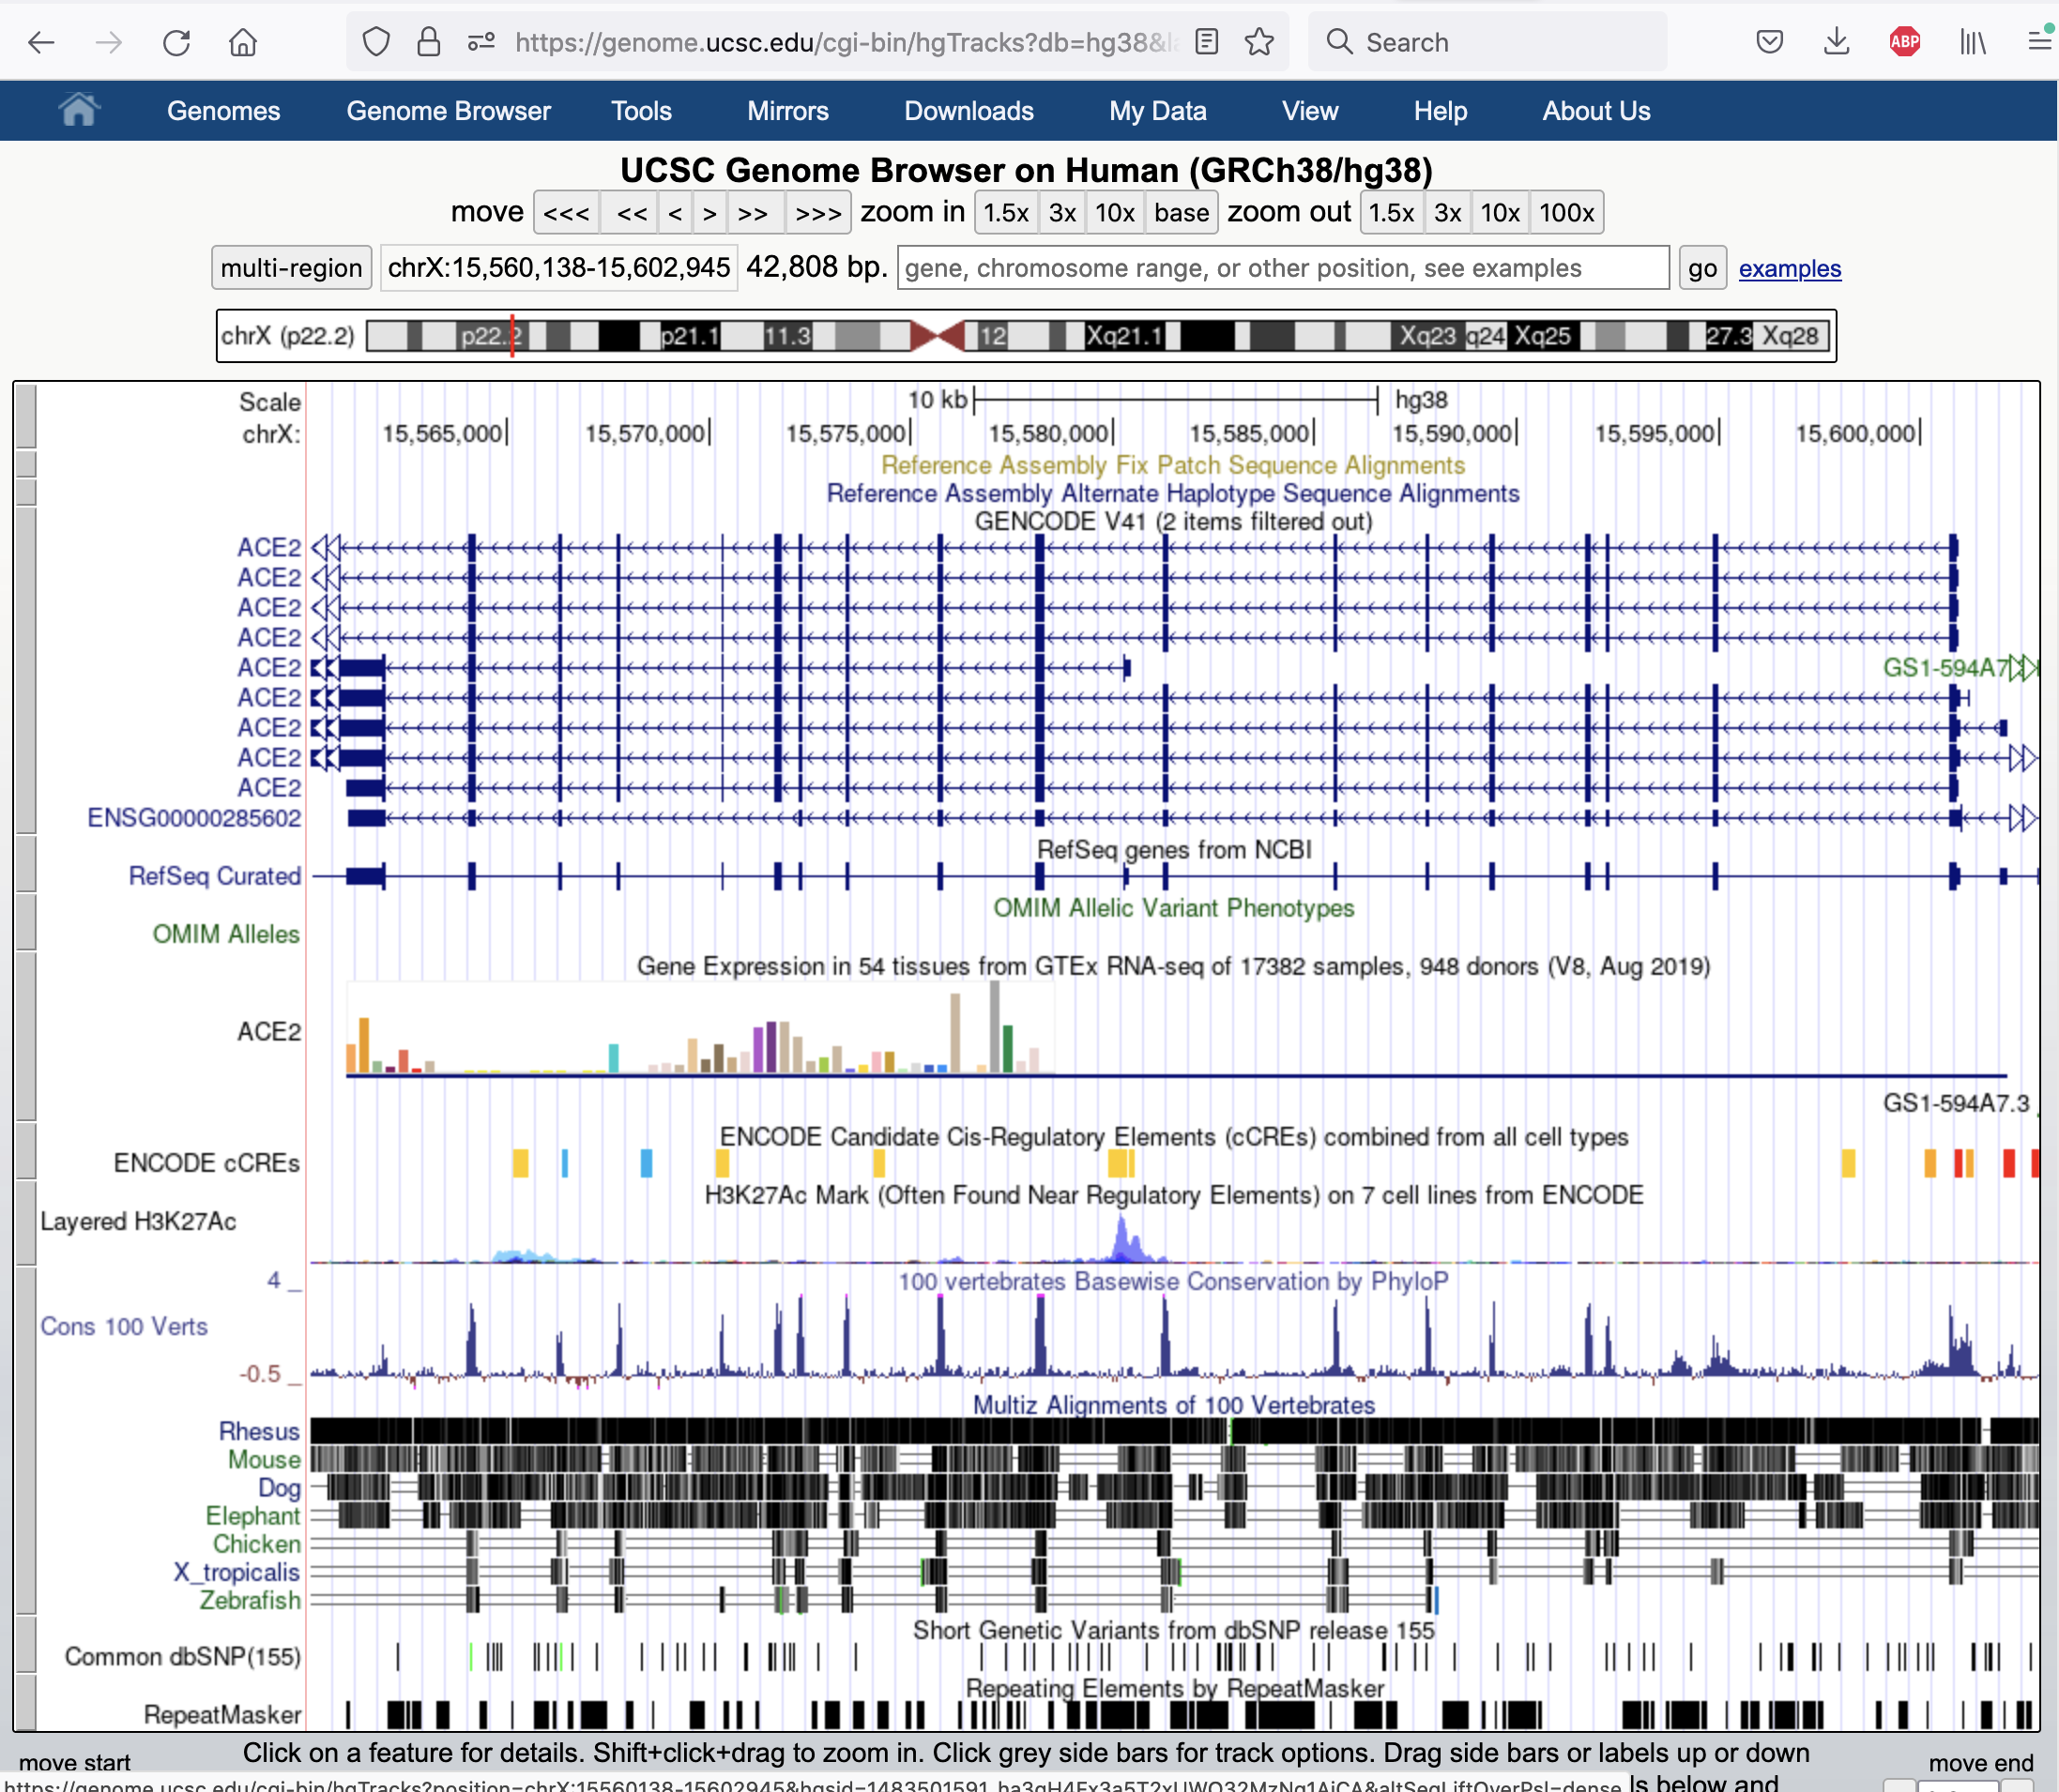
cgi-bin/hgTracks
default view
Notes:
The default view of a genome assembly and the annotations on that genome

Slide 11
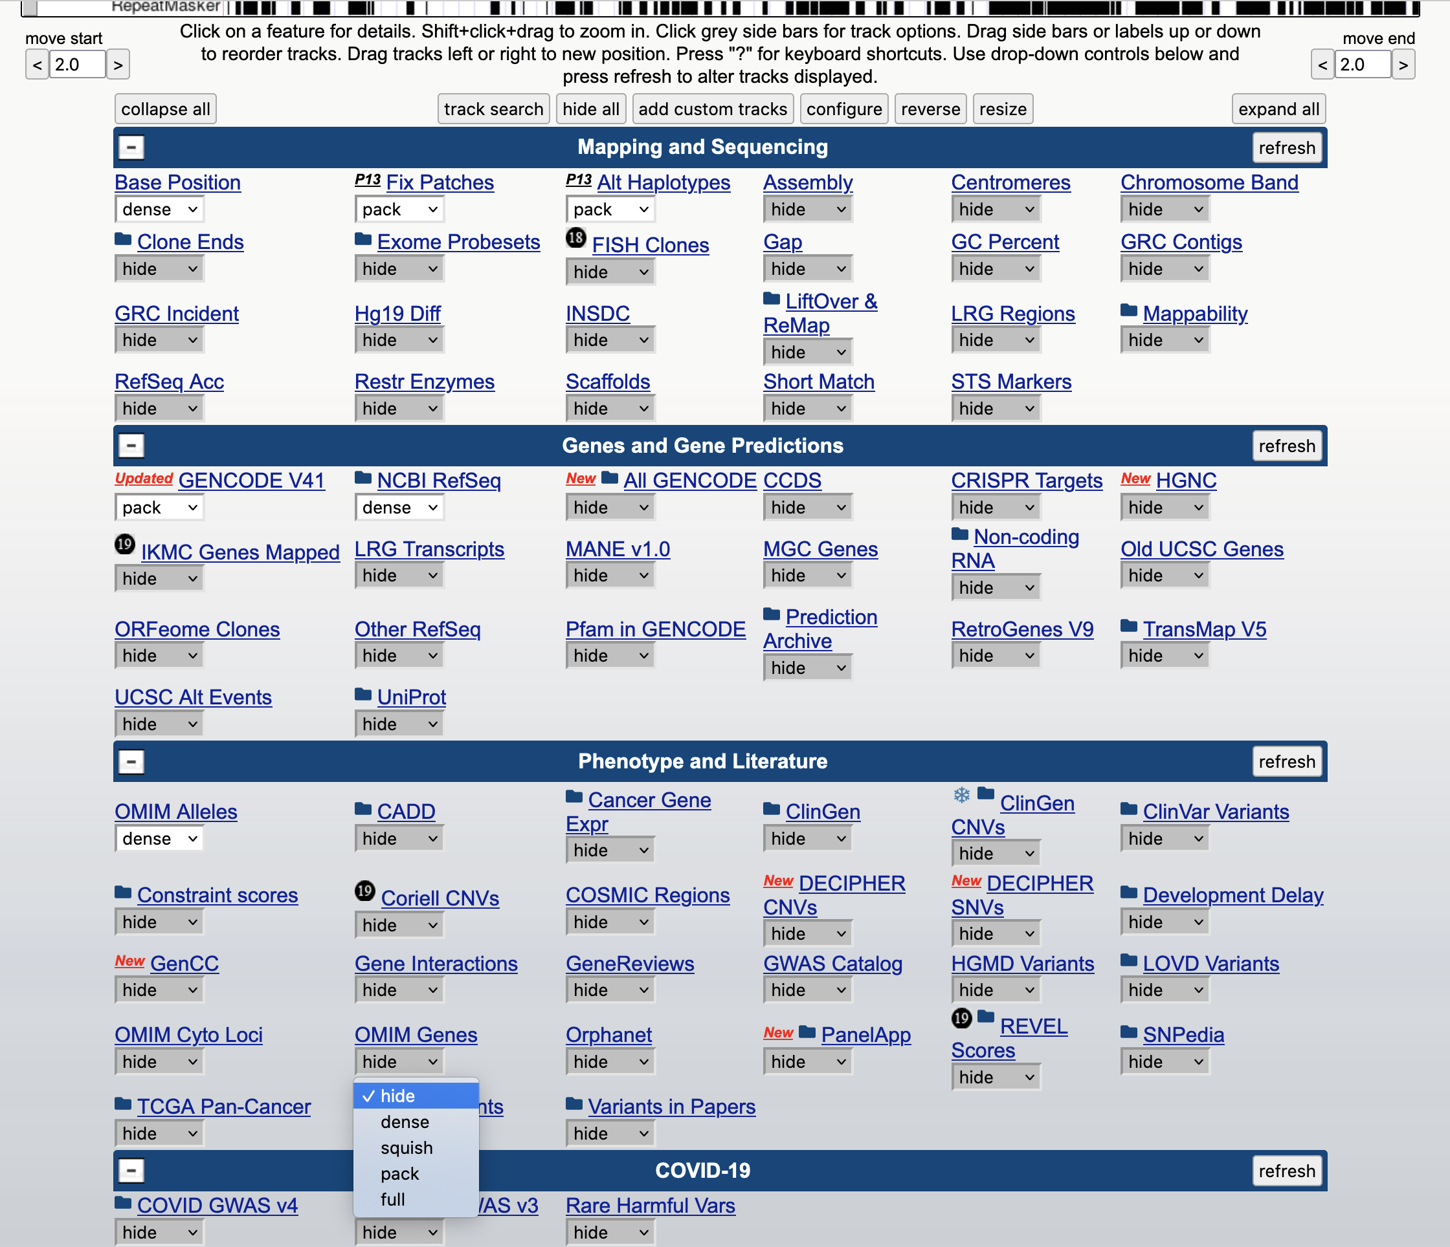
‘track’ controls
Notes:
The track controls below the main graphic image determine what is shown in the genome browser. There are thousands of annotations that can be shown.

Slide 12
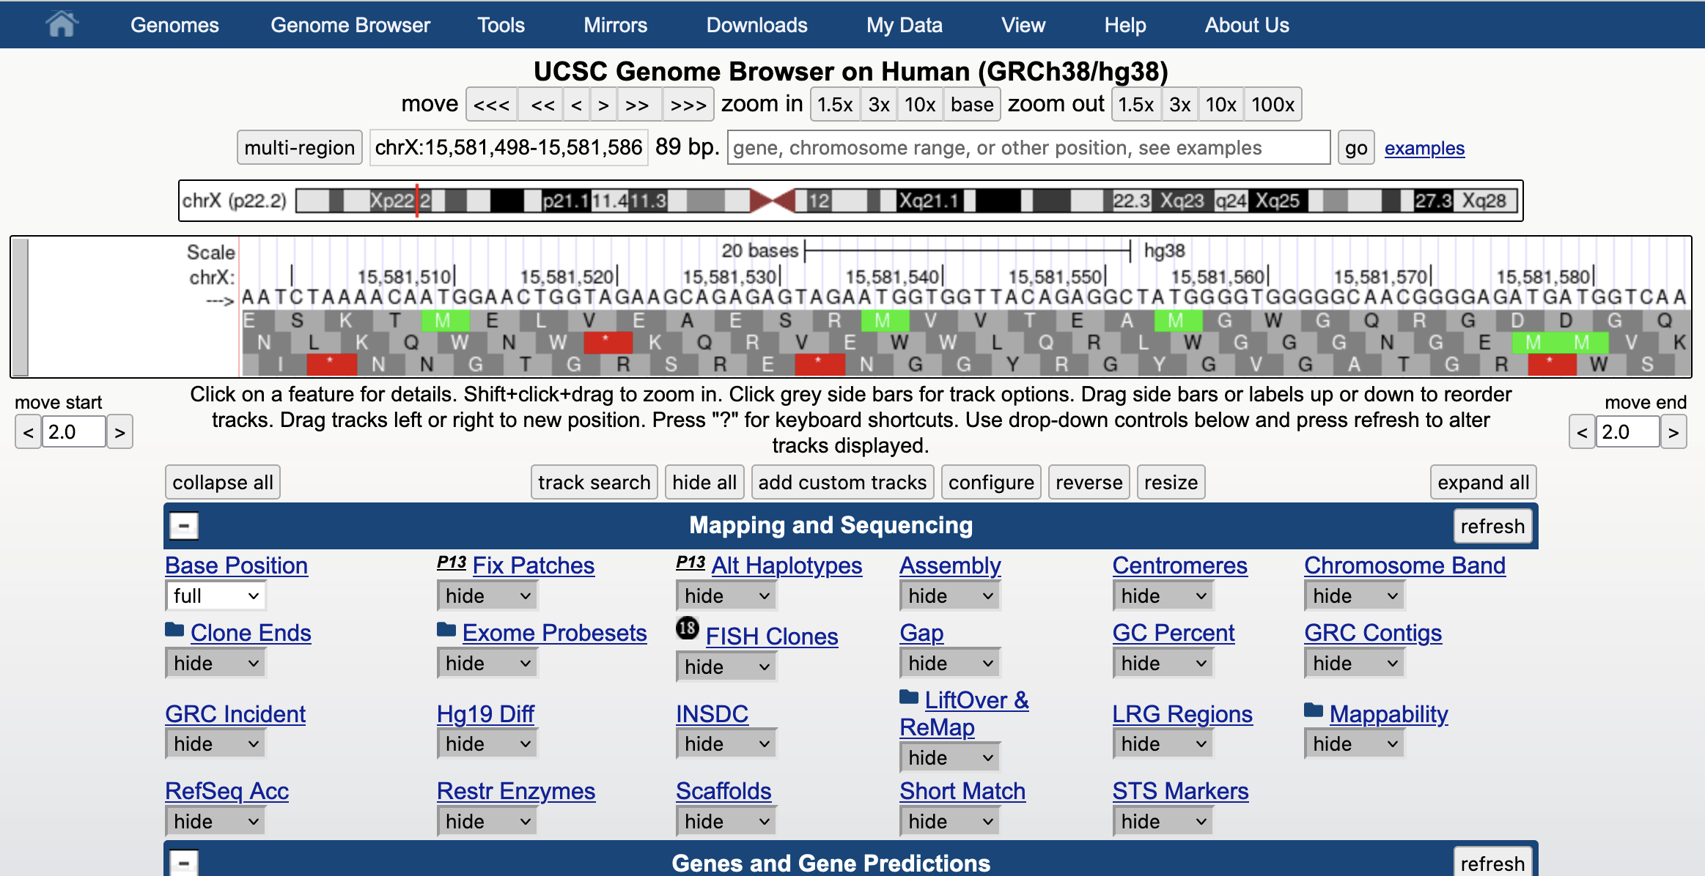
all tracks set to ‘hide’, ‘base’ track set to ‘full’, zoom in to ‘base’
Notes:
All tracks set to ‘hide’. The ‘base’ track set to ‘full’. ‘zoom in’ to ‘base’ view to see the actual nucleotides of the genome sequence.

Slide 13
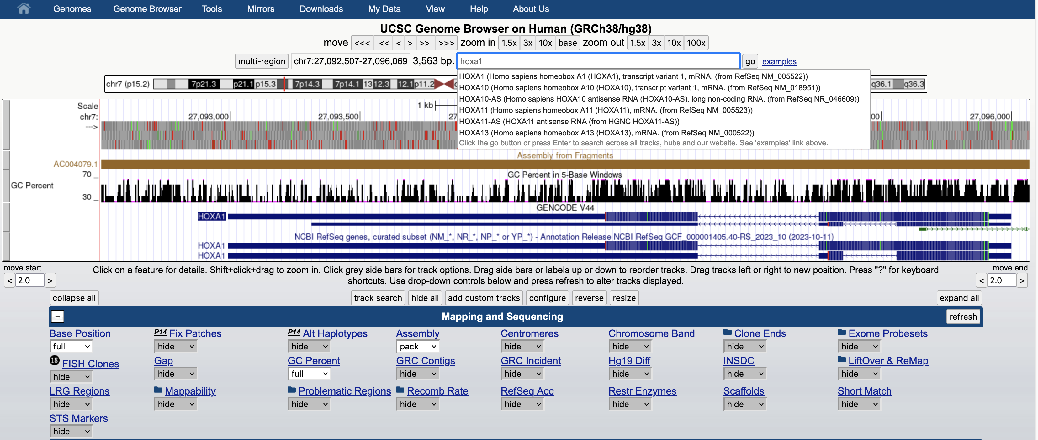
Use the search form to find items by name, e.g. gene HOXA1
Notes:
All tracks set to ‘hide’. The ‘base’ track set to ‘full’. ‘zoom in’ to ‘base’ view to see the actual nucleotides of the genome sequence.

Slide 14
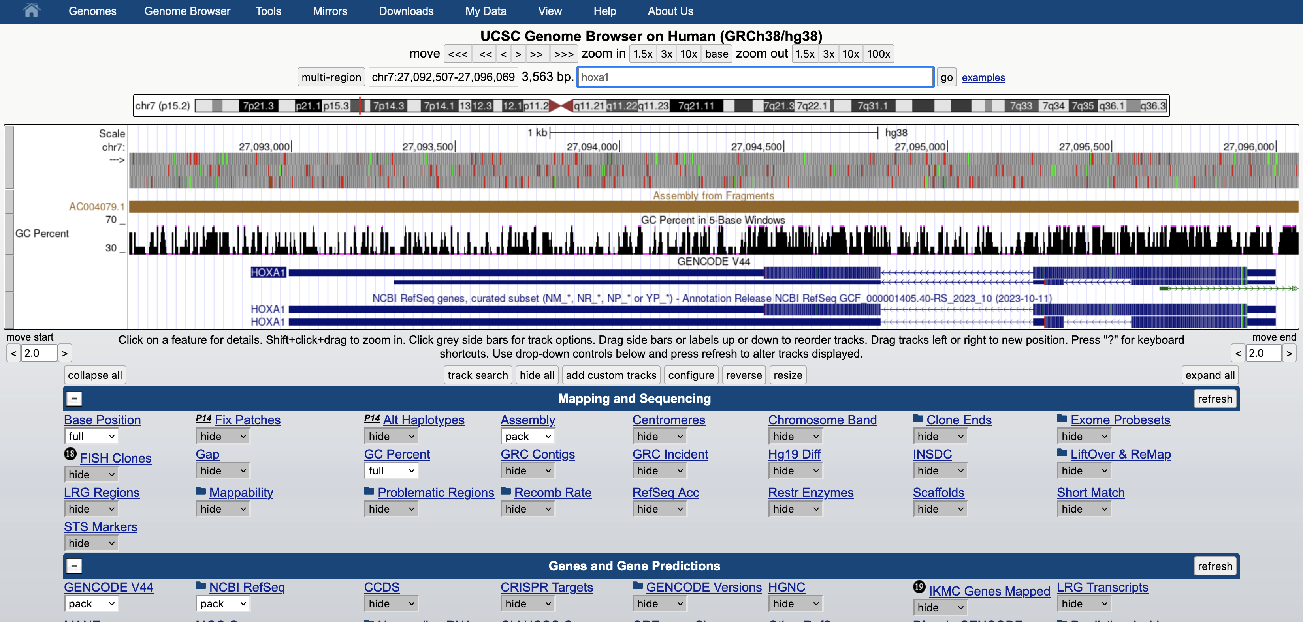
gene structure display in the browser
UTR- Untranslated region
Exon coding region
Intron non-coding region
Notes:
Gene display – UTR untranslated region – thin line, Exon coding region – thick line, Intron non-coding region – chevron arrows indicating direction of transcription
https://www.khanacademy.org/science/ap-biology/gene-expression-and-regulation/transcription-and-rna-processing/a/overview-of-transcription

Slide 15
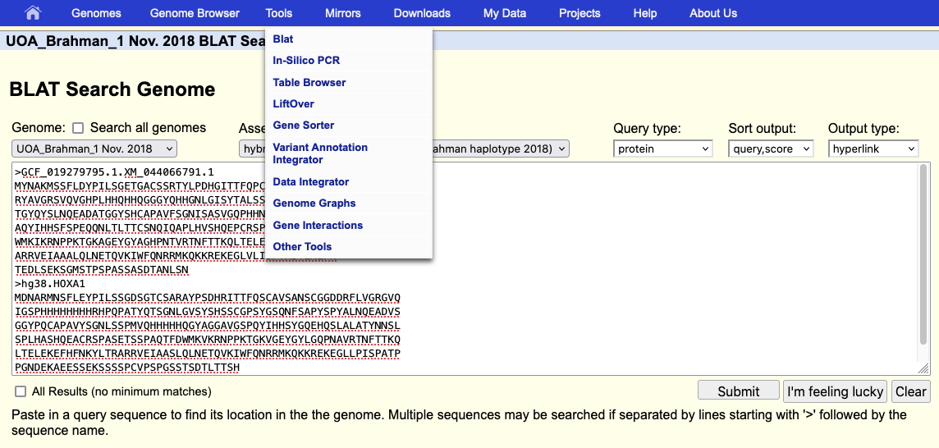
blat service now available on all assemblies
Notes:
The blat service was recently upgraded to handle very large genome assemblies. Previous limitation was a genome size of 4 Gbases.

Slide 16
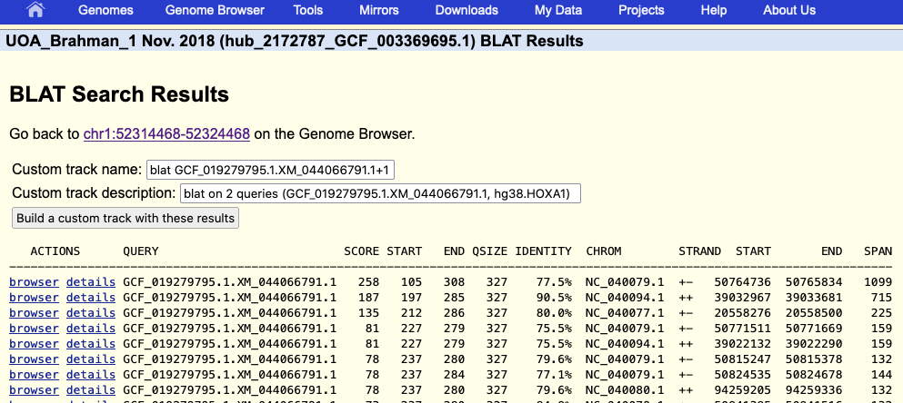
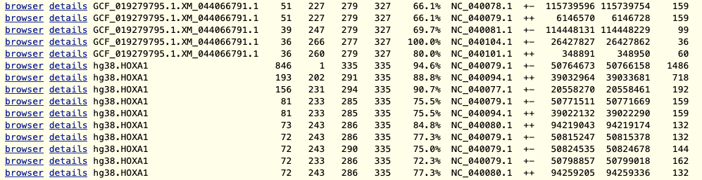
blat results
Notes:
From the blat results page, you can view the individual results, or build a custom track with all the results.

Slide 17
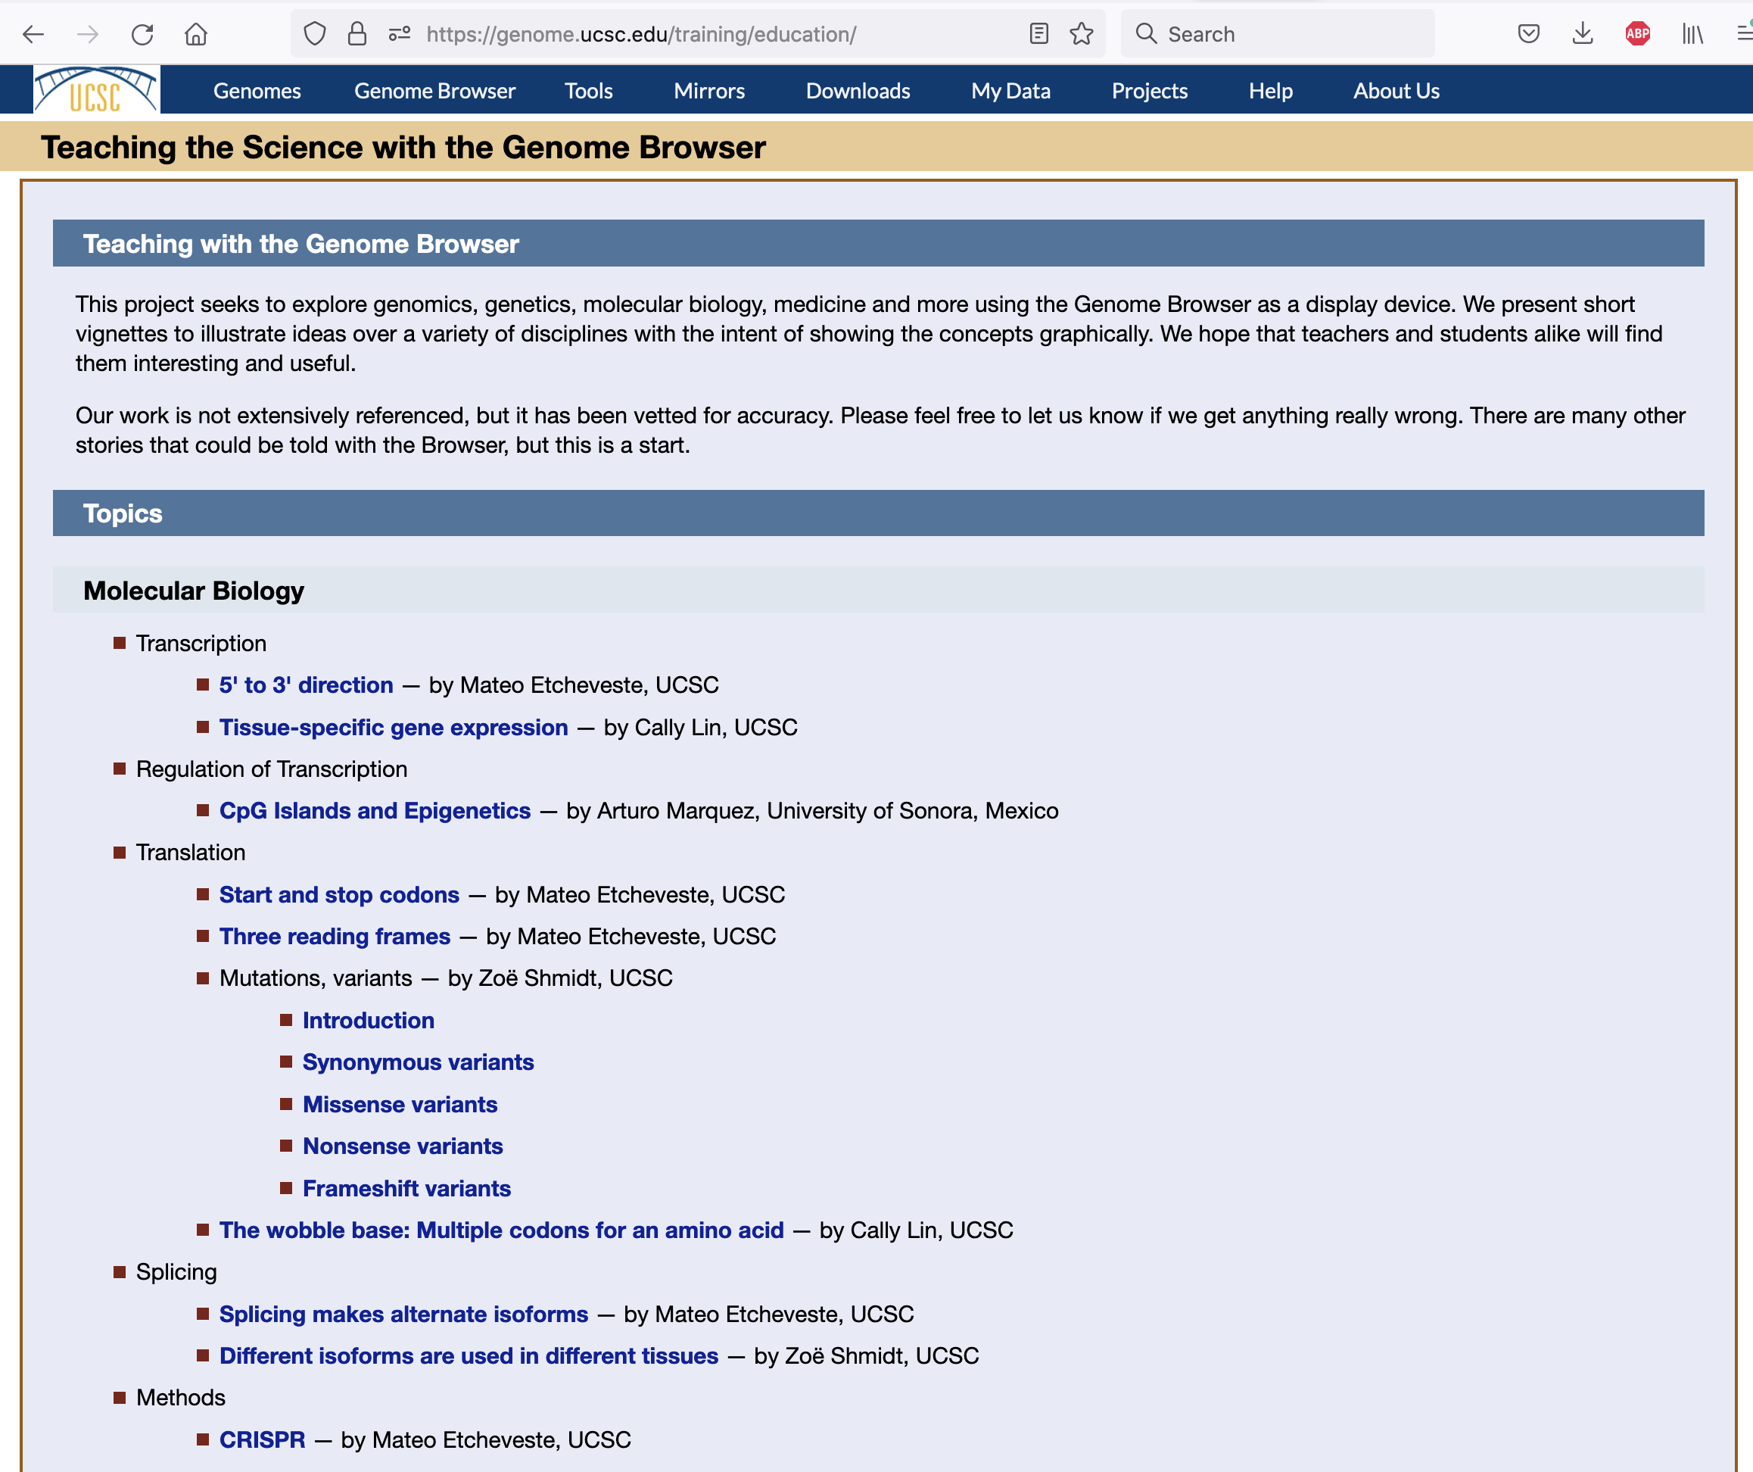
https://genome.ucsc.edu/training/education/
Notes:
Useful scenarios demonstrating biology topics using the genome browser. Leads to sessions in the browser where the demonstration can be use interactively.

Slide 18
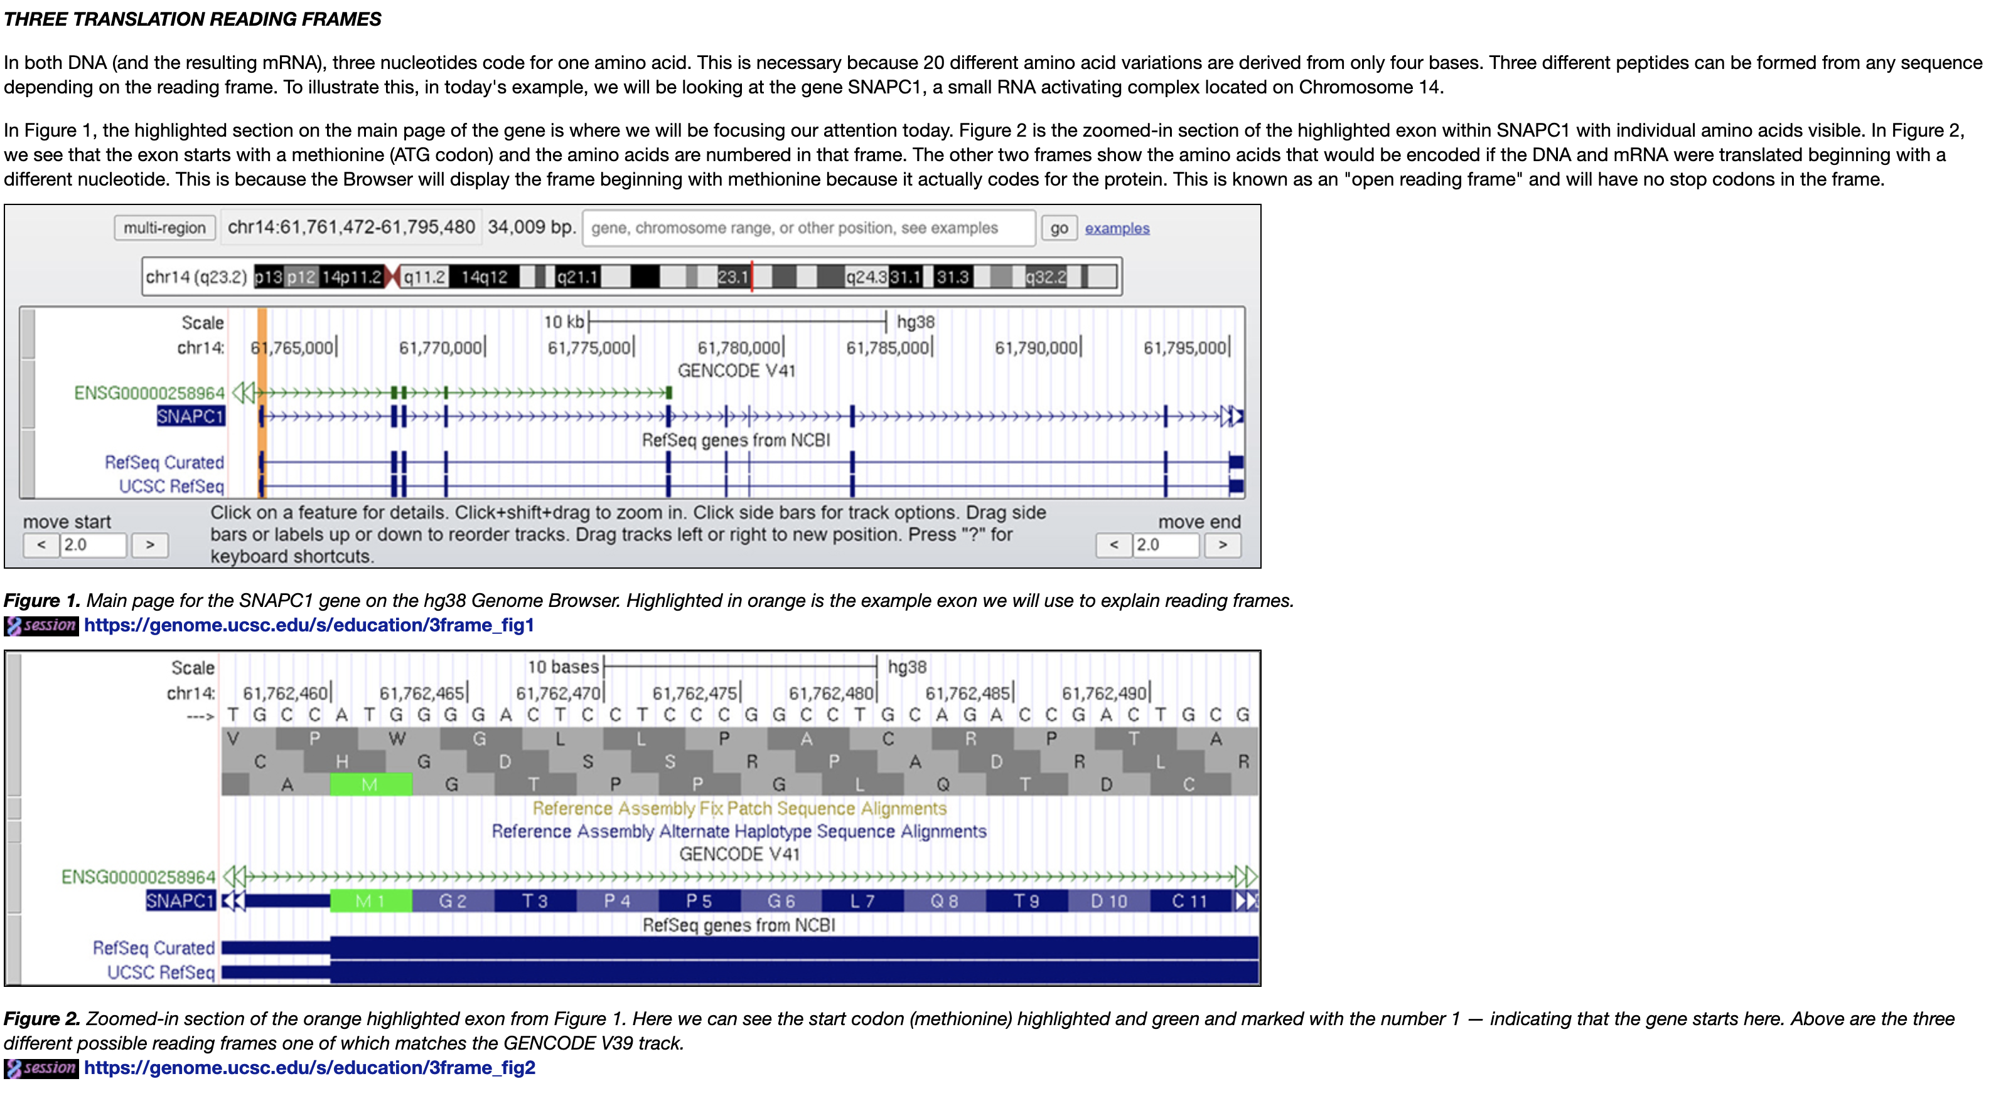
Three ‘Reading’ frames
Notes:
Sample lesson, what are ‘reading’ frames, why are there three. What about the ‘other’ three ?

Slide 19
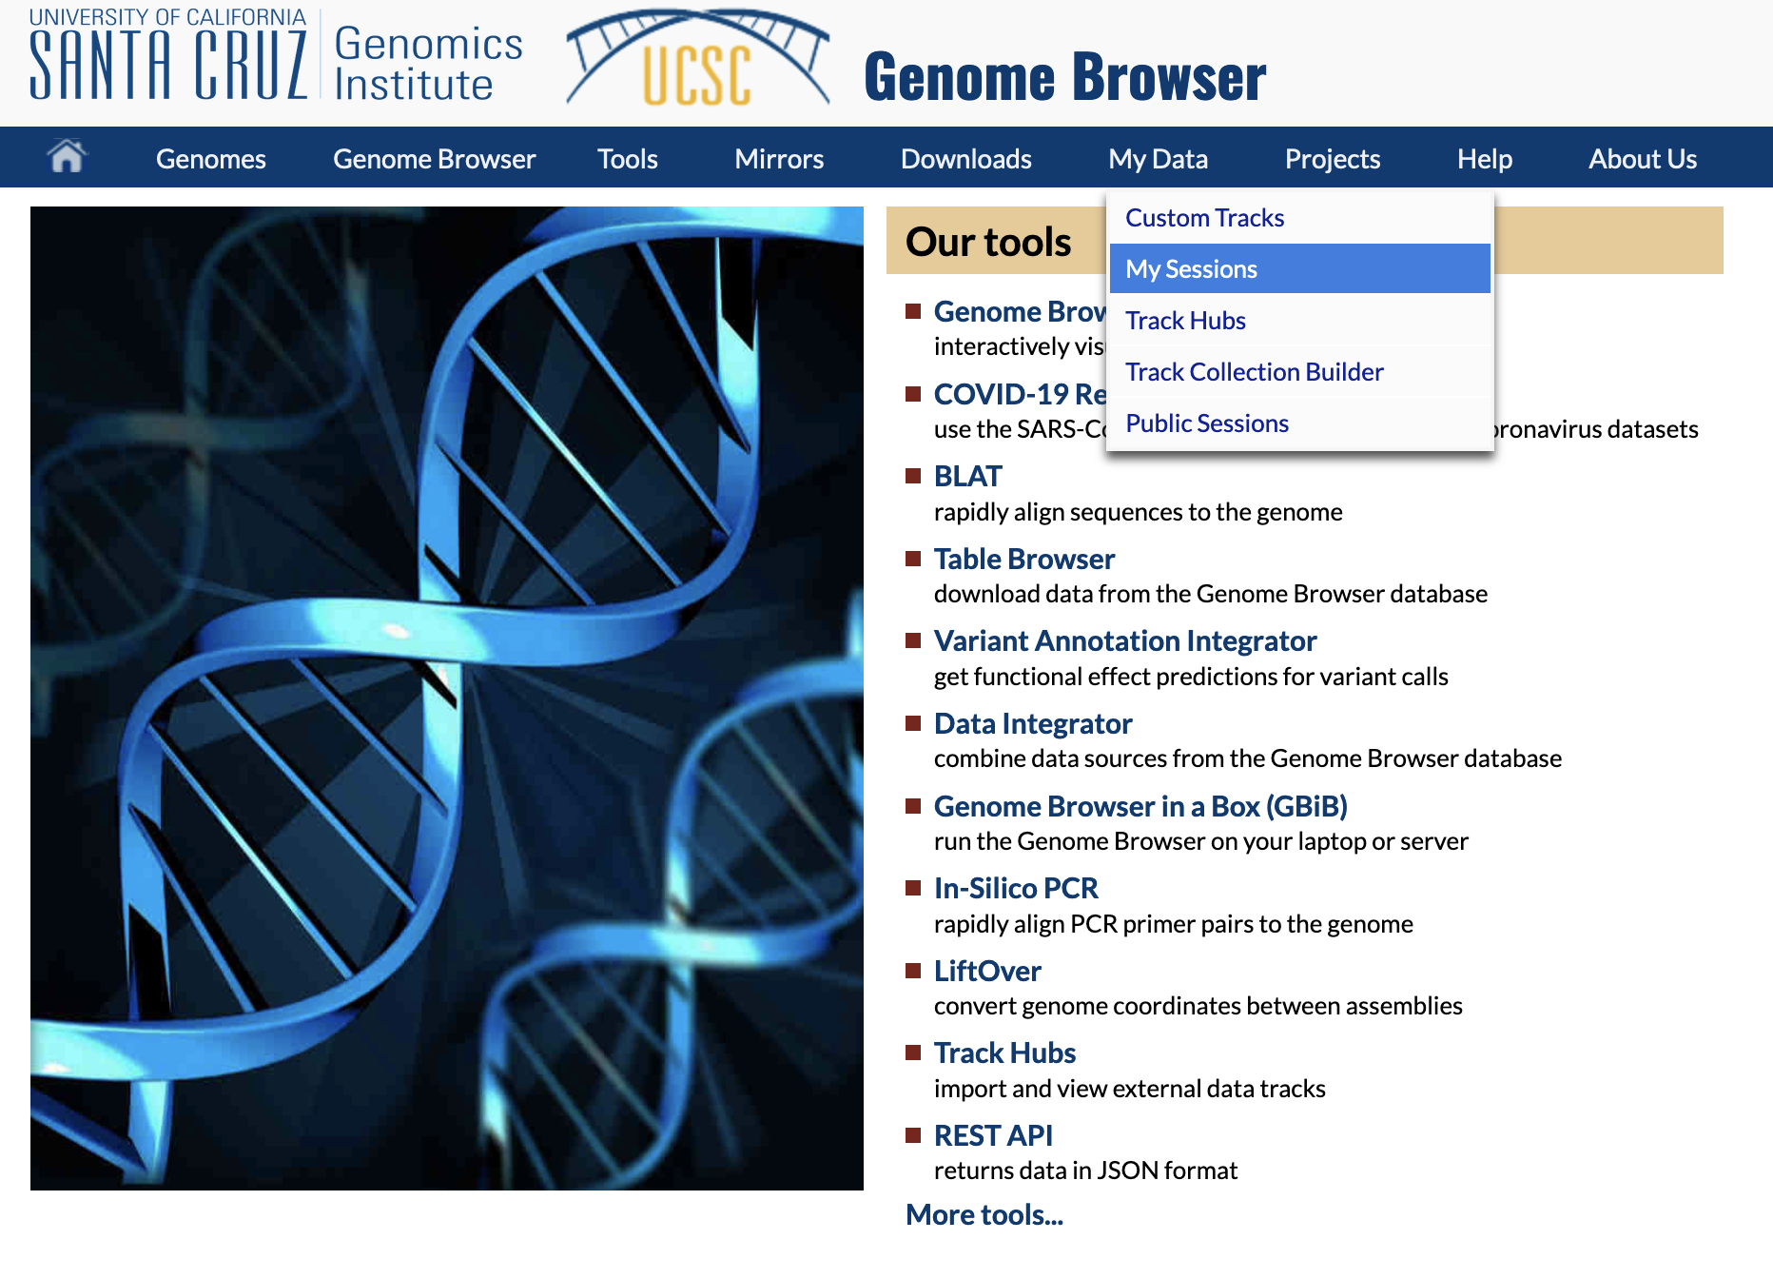
Create your own ‘sessions’ – views in the browser
See also: http://genome.ucsc.edu/goldenPath/help/sessions.html
Notes:
You can establish a login ‘account’ with the genome browser. With that account you can save ‘sessions’ – specific views of the genome browser configured to demonstrate something of interest. You can place your session in the ‘public’ list of sessions, or write to us private email at: genome-www@soe.ucsc.edu to suggest your session be used in the educational resources page.

Slide 20
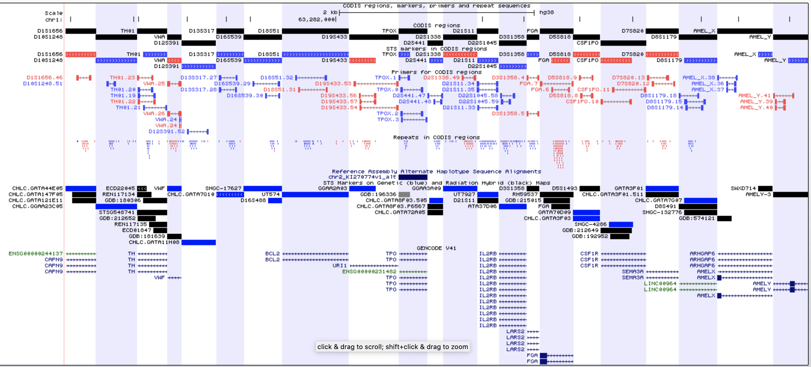
Leave you with a puzzle: how does DNA forensic identification work ?
https://genome.ucsc.edu/s/Hiram/hg38.codis
Notes:
What is CODIS ? What are DNA short tandem repeats ? What are the ethical considerations in such identification schemes ? https://genome.ucsc.edu/s/Hiram/hg38.codis

