Slide 1



Recent work on
Human Variation tracks
Genecats, April 6, 2011
Angie Hinrichs <angie@soe.ucsc.edu>

Slide 2
Overview
Genetic variation in 1 slide
dbSNP: background
dbSNP: more & better
VCF (1000 Genomes, …)
GVF (dbVar/ISCA)

Slide 3
Genetic variation
Differences in genomic sequence
  substitutions, insertions, deletions, copy number variation, …
  Allele: observed version of variant
We each have 2 sets of chrom’s
  Haplotype: one of the 2 sets
  Genotype: both sets
  Phased genotype: from Mom, from Dad
Polymorphism: variant fixed in a population (not just any old variant)

Slide 4

dbSNP
Warehouse for discovered variants
First submissions: late 1990s
Human build 132: 143M submissions
Provides stable IDs for variants
“SNP” somewhat of a misnomer
Garbage in, garbage out

Slide 5
dbSNP’s monumental task
143,350,315 of these for human:
dbSNP
Submitter: DEBNICK
Left Flank: …GCAGAACTGT
Right Flank: AGCACCTTCA…
Obsvd Alleles: A/C
Sample Size: ? [50]
Population(s): ? [HAPMAP YRI]
Individual(s): ? [NA18489, NA18…
Genotypes: ? [NA18489:AA, …
Allele Freqs: ? [A:94.1%, C:…
Linkout: ? [http://mylab…
External IDs: lp00110
...
Nickerson lab
…
Kwok lab
1000 Genomes
…
HapMap

Slide 6
dbSNP’s mapping process
ss247 left flank
ss247 right flank
…GCAGAACTGT
AGCACCTTCA…
BLAST
BLAST
genome
…TTTATTTTTGGCAGAACTGTAAGCACCTTCATTTTCTTTTT…
…TTTATTTTTGGCAGAACTGTAAGCACCTTCATTTTCTTTTT…
…
…
…
…
…
…
…
…
…
Join flanking alignments
ss247
ss129807195
…
…
…
…
…
…
…
…
…
ss223585613
Cluster into Reference SNPs
rs247

Slide 7
UCSC’s little slice of dbSNP
Only Reference SNP clusters (rs#), not Submitted SNPs (ss#)
Only SNPs mapped to reference genome (not Celera, Venter etc)
BED6 + ten attributes out of dozens

Slide 8
UCSC’s extra sauce
18 anomalous conditions: “Exceptions”
Noted on details page
Used internally to filter SNPs e.g. before cross-species liftOver

Slide 9
Mary-Claire King’s kick in the A
dbSNP’s “clinically associated” SNPs are indistinguishable in our track
Need subset for filtering out boring variation

Slide 10
Souping up our SNPs track
More info for discerning users
Categorization -> subset tracks
Genome Browser: colors, filters, details

Slide 11
New data columns
Submitter handles
Allele Frequencies
dbSNP flags: “clinically associated” and a few others
Separate table of exceptions pulled into main table as mysql set column

Slide 12
SNP subsets:
Common, Flagged, Multi-Mapped
All SNPs
33M
Uniquely mapped?
NO
Mult. SNPs
3.5M
YES
MAF >= 1% ?
YES
Common SNPs
14M
NO
“Clinically Associated”?
YES
Flagged SNPs
18k
15.4M

Slide 13
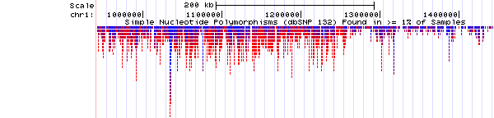
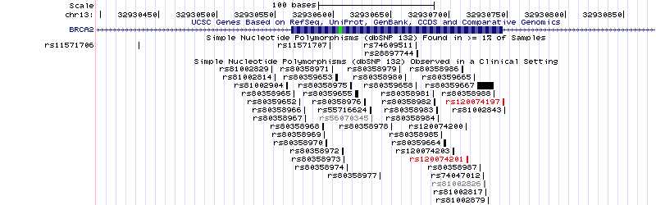
Genome Browser SNPs track: new coloring and filtering options
Color by allele frequency (red=rare, blue=common):
Color by exception (anomaly), if any:

Slide 14
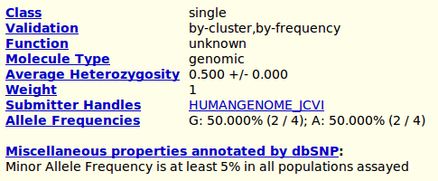
Genome Browser SNPs track: fun with new details
Single-submitter SNPs often have some issues:
?
old
new
?

Slide 15
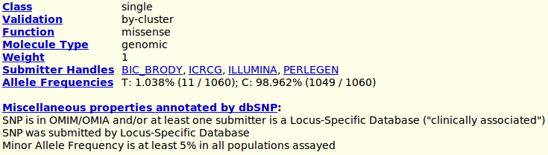
Genome Browser SNPs track: fun with new details
4 submitters, 1060 chromosomes:
!

Slide 16
New data sources and formats
tabix: make any old text format fast like bigBed!
1000 Genomes: VCF
dbVar / ISCA: GVF

Slide 17
tabix: compress & index any old line-based text format
bgzip (block-based gzip) compression, like BAM
Tell tabix which columns have sequence name and start offset
Voila! BAM-like binary index file

Slide 18
Variant Call Format (VCF)
Developed for 1000 Genomes project
Goals:
  Describe diverse types of variation
  Support user-defined structured data
  Not bloated
Data definitions in header

Slide 19
VCF: define data fields in header
##fileformat=VCFv4.0
##INFO=<ID=DP,Number=1,Type=Integer,
Description="Total Depth">
##INFO=<ID=HM2,Number=0,Type=Flag,
Description="HapMap2 membership">
##INFO=<ID=AA,Number=1,Type=String,
Description="Ancestral Allele, ftp://ftp.1000genomes.ebi.ac.uk/vol1/ftp/pilot_data/technical/reference/ancestral_alignments/README">

Slide 20
VCF+tabix = custom track
track
name=CEU_lowCov_pilot_genotypes
type=vcfTabix
bigDataUrl=ftp://ftp-trace.ncbi.nih.gov/1000genomes/ftp/pilot_data/release/2010_07/low_coverage/snps/CEU.low_coverage.2010_07.genotypes.vcf.gz
visibility=pack
db=hg18

Slide 21
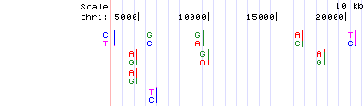
VCF example:
SNPs with allele counts
Convert to pgSnp items for display:

Slide 22
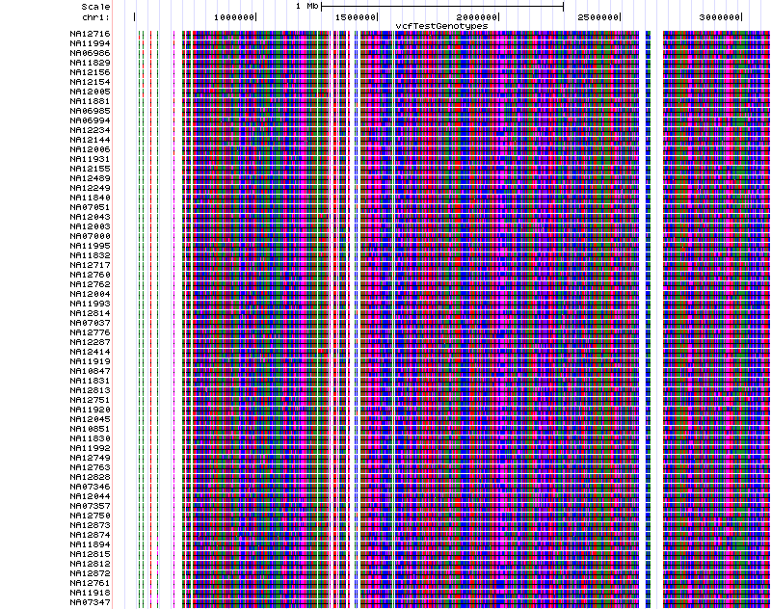
VCF example:
SNPs with genotypes

Slide 23
Genome Variation Format (GVF)
Based on GFF3; additional attributes
chrY dbVar Gain 2714852 57440868 . . . ID=nssv579294;Name=nssv579294(Gain);
Parent=nsv494707;var_type=Gain;
Start_range=.,2714852;End_range=57440868,.;clinical_int=Uncertain Significance: likely pathogenic;samples=ISCA_ret_id_2795;
phenotype=Developmental Disabilities

Slide 24
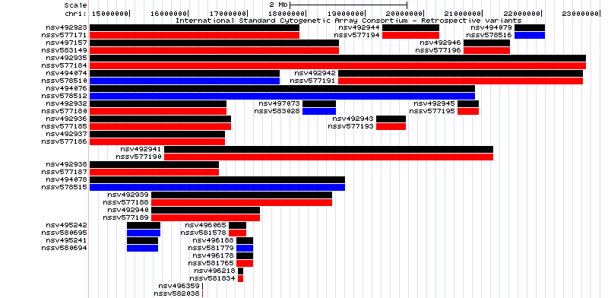
ISCA Retrospective
(GVF from dbVar)

Slide 25
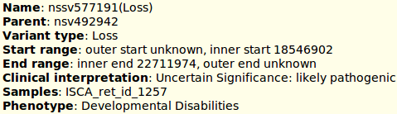
ISCA Retrospective - details

Slide 26
Thanks!

