Slide 1
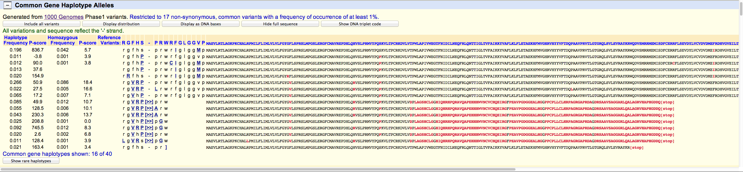


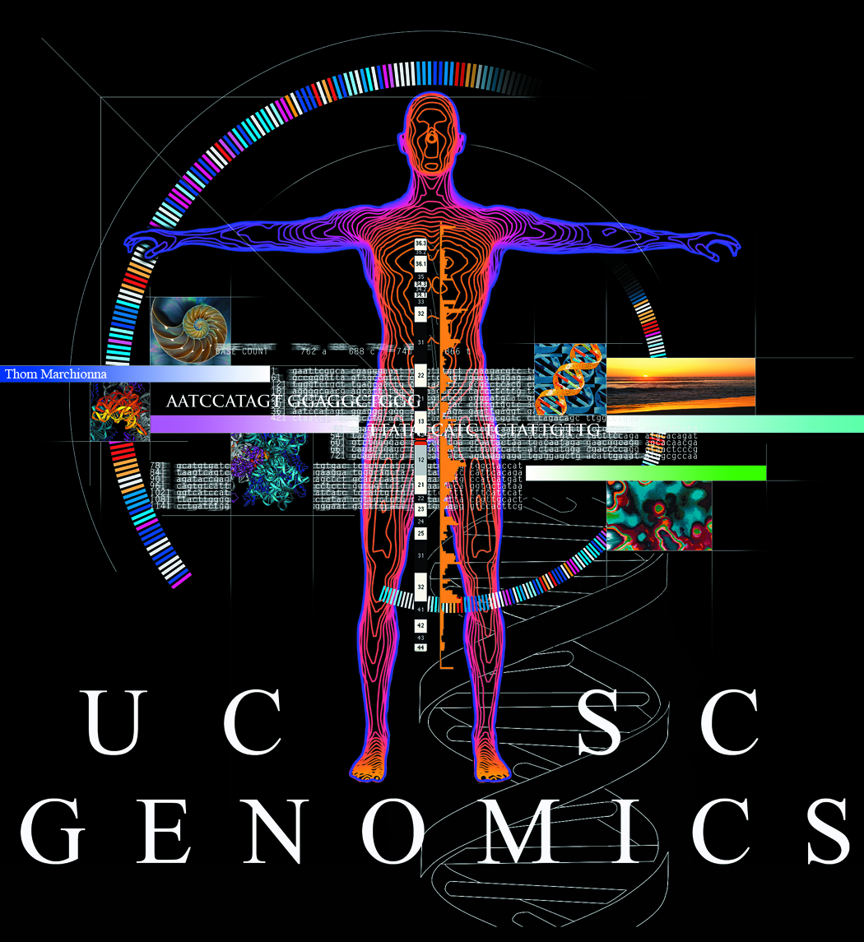
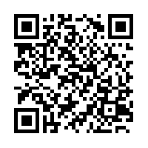

New variation resources at the UCSC Genome Browser
Brooke Rhead, Angie S. Hinrichs, Timothy R .Dreszer, Brian J. Raney, Robert M. Kuhn, Ann S. Zweig, Donna Karolchick, W. James Kent
Annotate your variants:
View 1000 Genomes haplotype alleles:
Click on a gene in the UCSC Genes track:
Scroll to new section:
Haplotype and homozygosity frequencies. Columns are sortable.
This section summarizes the changes in each haplotype allele.
Display haplotype alleles as DNA or amino acids. This gene (ABO) shows a frameshift mutation in several haplotype alleles.
This work was funded by the National Human Genome Research Institute award U41HG002371 to the UCSC Center for Genomic Science.
See our wiki for more details:
http://genomewiki.ucsc.edu/index.php/BoG2013VariationPoster

