Slide 1


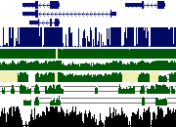




Hiram Clawson
U.C. Santa Cruz
Genome Browser
09 June 2016

Slide 2
Genome Assemblies
In the beginning:
a. one
b. two
c. many
Standardization:
A: GENBANK
B: REFSEQ
Acceptance:
UCSC
NCBI
Ensembl
www.ncbi.nlm.nih.gov/assembly/
Notes:
In the beginning there was one genome assembly. Then along came another. It wasn’t long before there were many. These early genomes were obtained directly from assembly center FTP sites. Versioning was a problem. In stepped the standardization committee. NCBI organized the assembly management system. Assembly sequences are accessioned, assemblies are accessioned, every part takes on a number identity. UCSC, NCBI and Ensembl agree to use only these accessioned assemblies.

Slide 3
Naming schemes
UCSC: chr1, chr2, … chr22, chrX, chrY, chrM
Ensembl: 1, 2, … 22, X, Y, MT
Genbank: CM000663.2, CM000664.2
Refseq: NC_000001.11, NC_000002.12
chr16_KI270728v1_random
chr6_GL000256v2_alt
chrUn_KI270442v1
Notes:
UCSC established the ‘chrN’ naming scheme. Ensembl liked the ‘N’ naming scheme. NCBI/Genbank/RefSeq has many naming schemes, accession names. ‘random’ sequences are known to be on a specific chromosome, but not yet located. ‘alt’ sequences are alternate haplotype sequences to the primary reference sequence. ‘chrUn’ sequences do not have assigned chromosome identities.

Slide 4
UCSC genomes
hg38 – 38th human genome assembly
mm10 – 10th Mus musculus assembly
gorGor4 – 4th Gorilla gorilla gorilla
panPan2 – 2nd Pan paniscus (bonobo)
hgsql -e 'select name,organism,scientificName,taxId
from dbDb;' hgcentral
Count: 277 total public site, 164 species,
516 total hgwdev, 331 species
Notes:
Very early assemblies at UCSC where two letters and a number. Soon adopted the abcDefN naming scheme, from the scientific name. Has been working well so far, will eventually have clashes. Some are already abcDefGhiN. Database table ‘dbDb’ in database ‘hgcentral’ has assembly information.

Slide 5
Assembly hubs
Prototype experiment
genome-preview.cse.ucsc.edu/gbdb/hubs/refseq/
33,772 species, 50,718 assemblies
genome-preview.cse.ucsc.edu/gbdb/hubs/genbank/
36,944 species, 62,096 assemblies
Notes:
Assembly hubs allow use of novel genome assemblies in the UCSC genome browser without any database tables at UCSC. All independent of UCSC. Users with assembled genomes can view their sequence by placing files on a WEB site under their control.

Slide 6
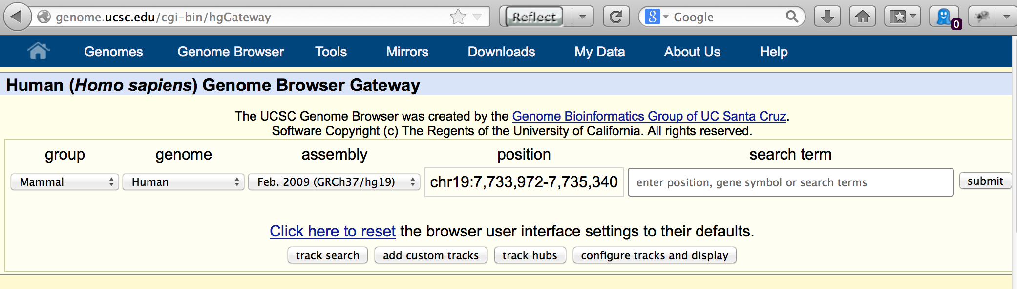
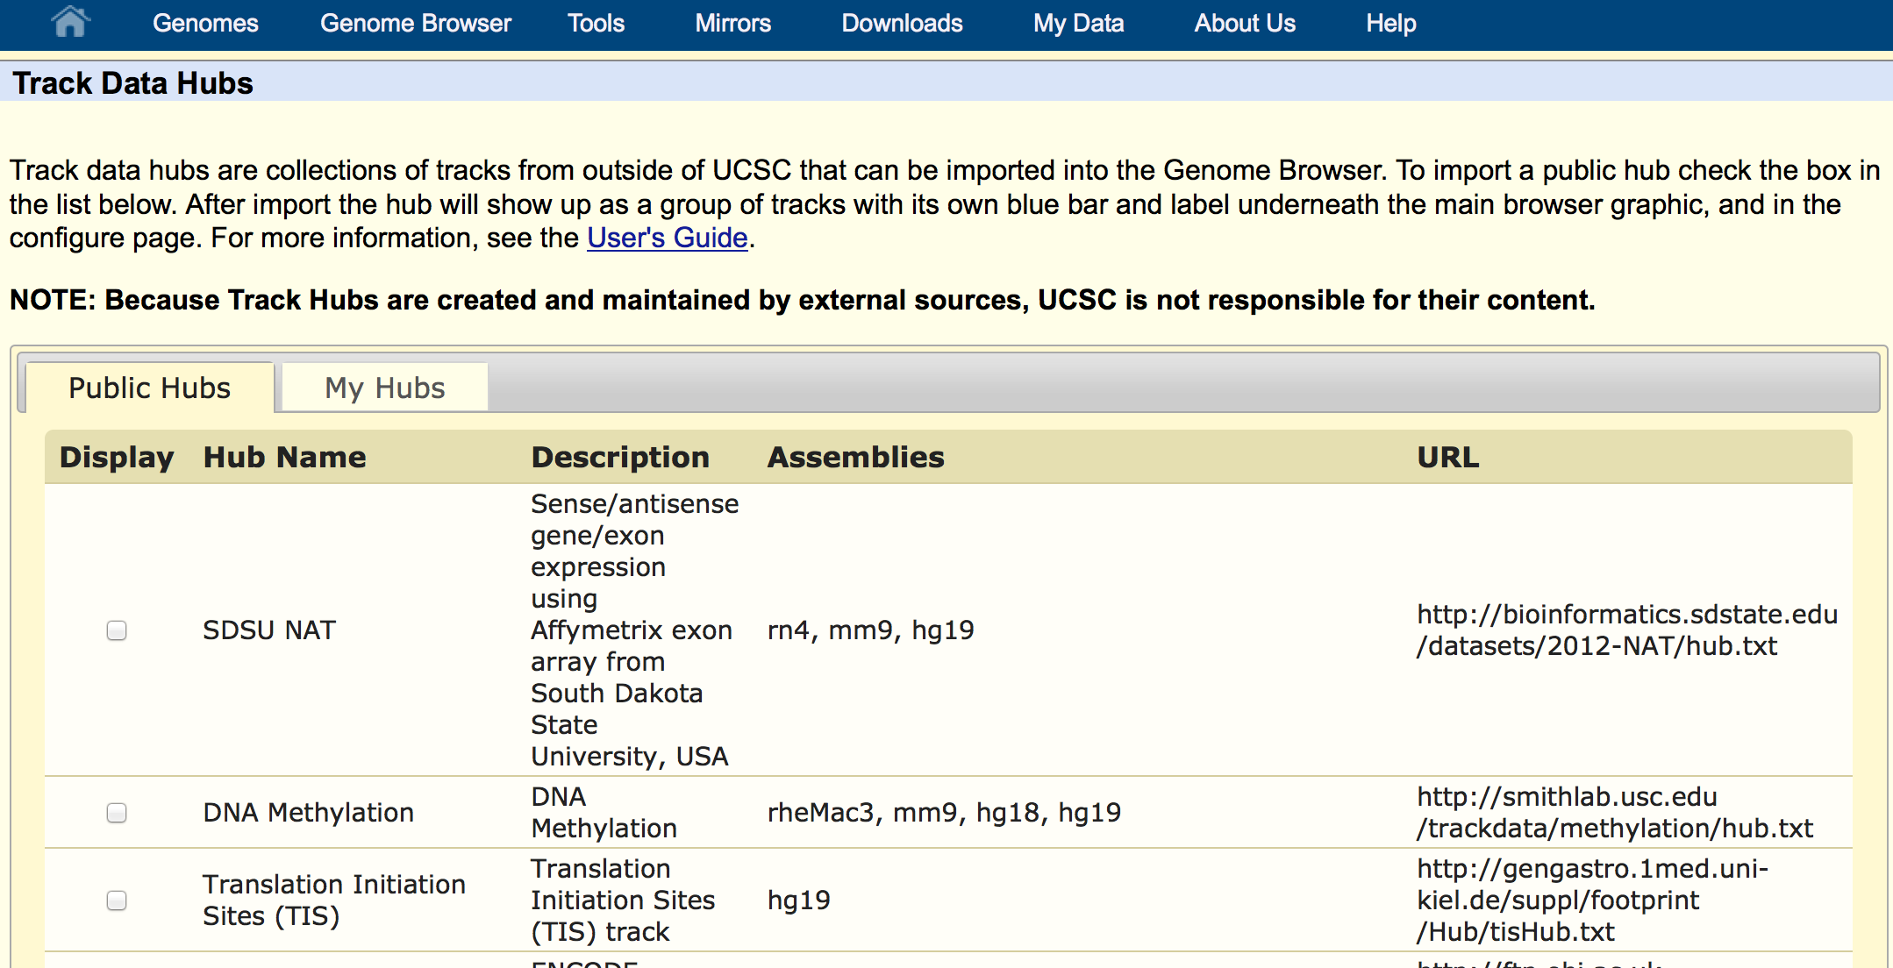
Assembly/Track hubs
http://genome.ucsc.edu/goldenPath/help/hgTrackHubHelp.html
Notes:
The track hub management page will be on the “Public Hubs” on first viewing. Click on the “My Hubs” tab to work with your own track/assembly hubs.

Slide 7
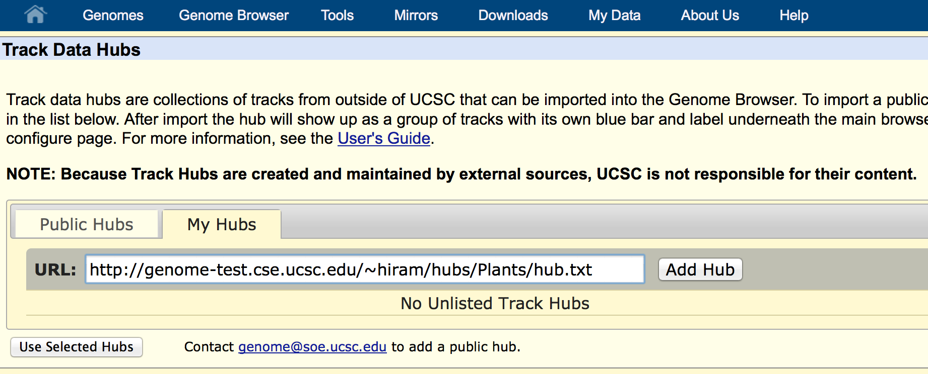
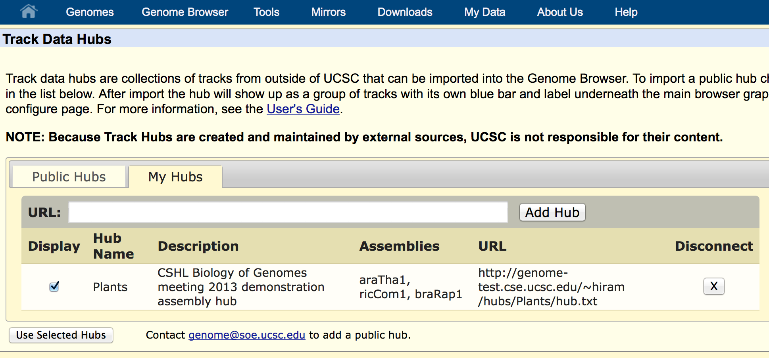
My Hubs URL entry
Notes:
Enter a URL to your ‘hub.txt’ file to use your data. Click on the “Add Hub” to pass your data on to the genome browser. Your hub’s information will show up on the list. Click on the “Genomes” blue navigation link to get to the ‘gateway’ page.

Slide 8
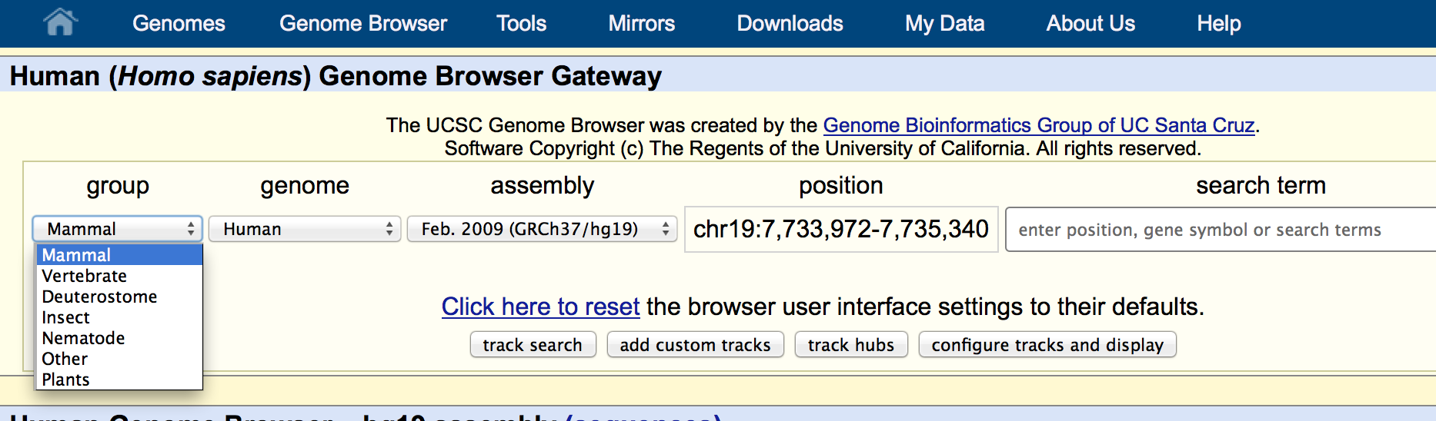
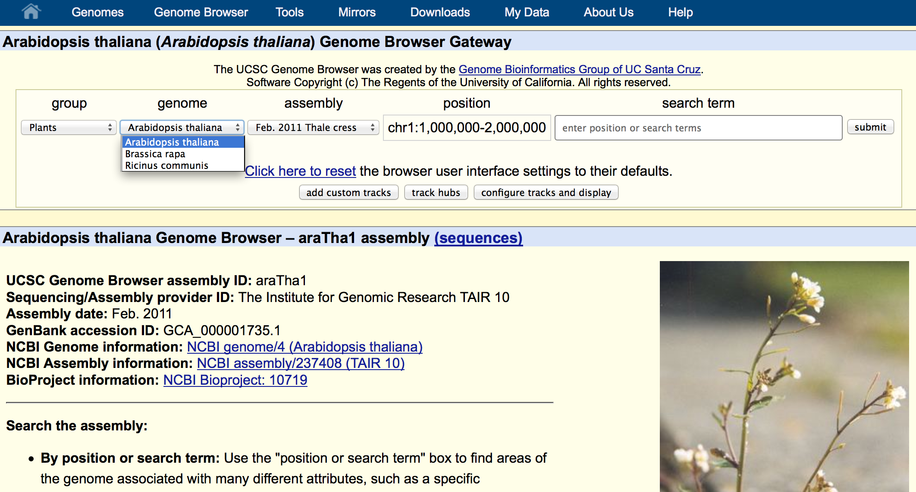
Gateway page hub selection
Notes:
With your assembly hub in the system, your genome “group” will now show up on the pull-down menu, with your multiple genomes on the ‘genome’ pull-down menu.

Slide 9
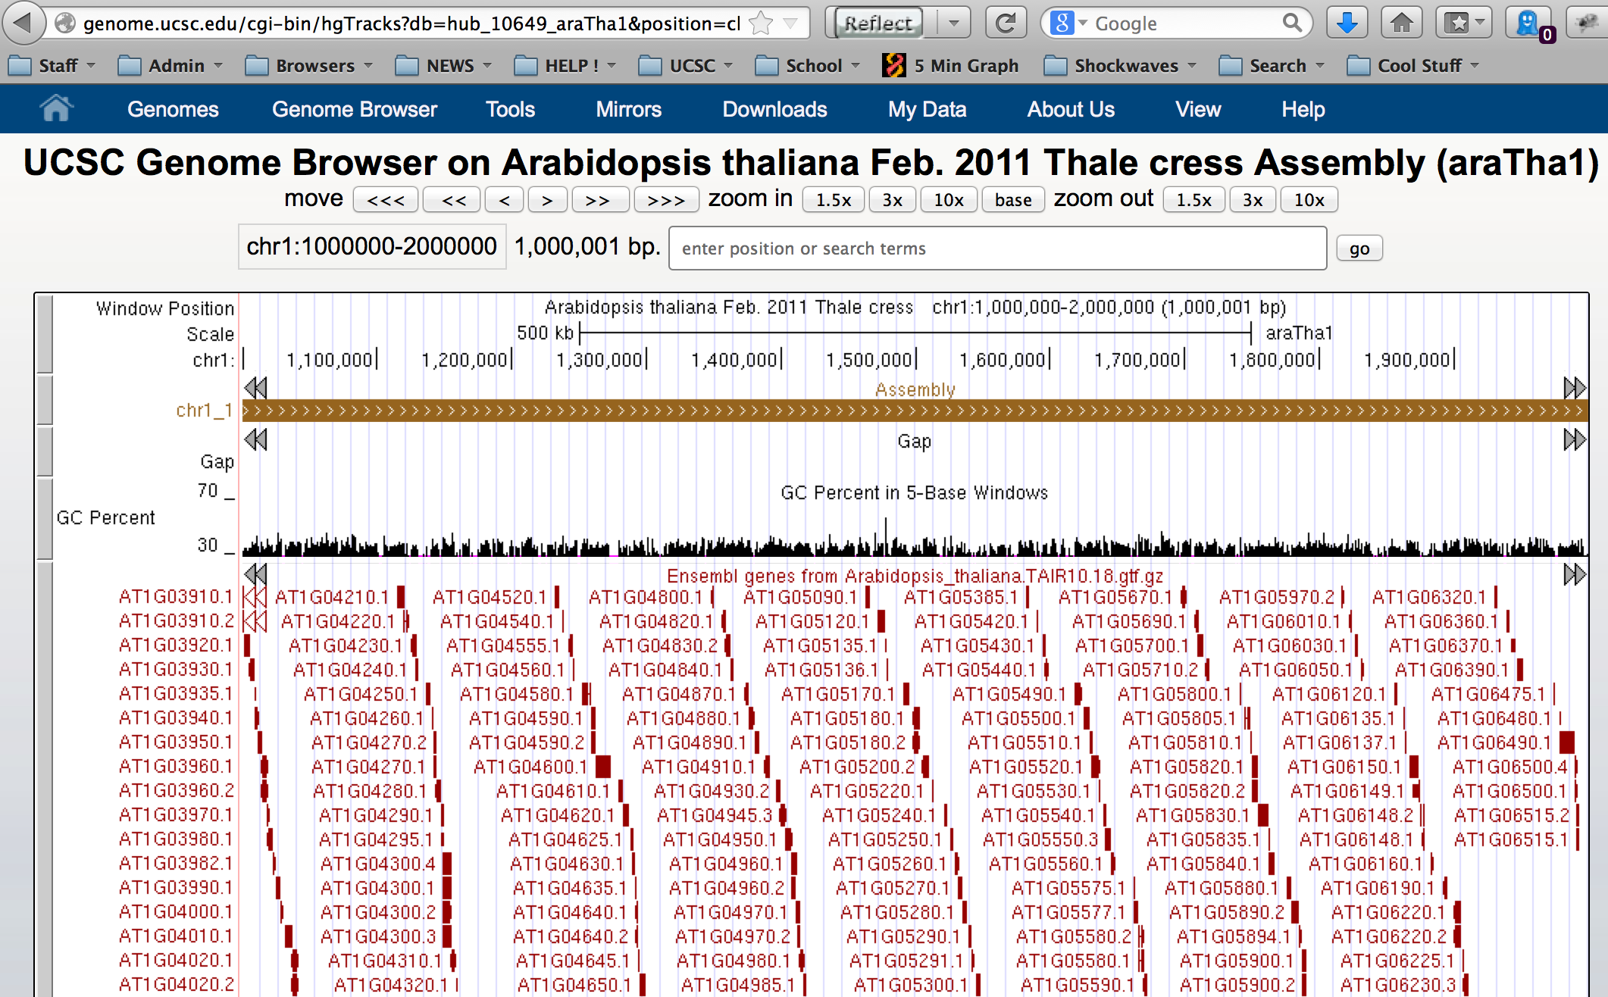
External genome sequence display
Notes:
Your external genome sequence can now be used in the genome browser with most of the genome browser features enabled.

Slide 10
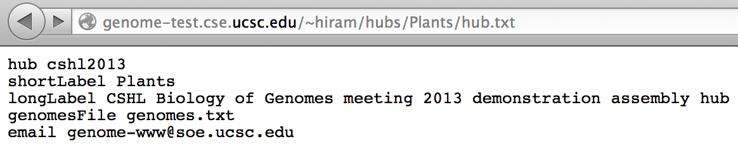
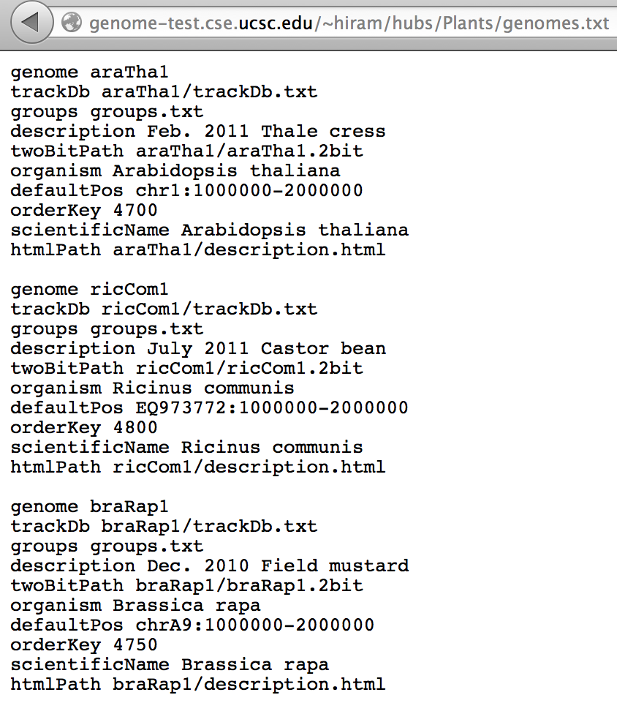
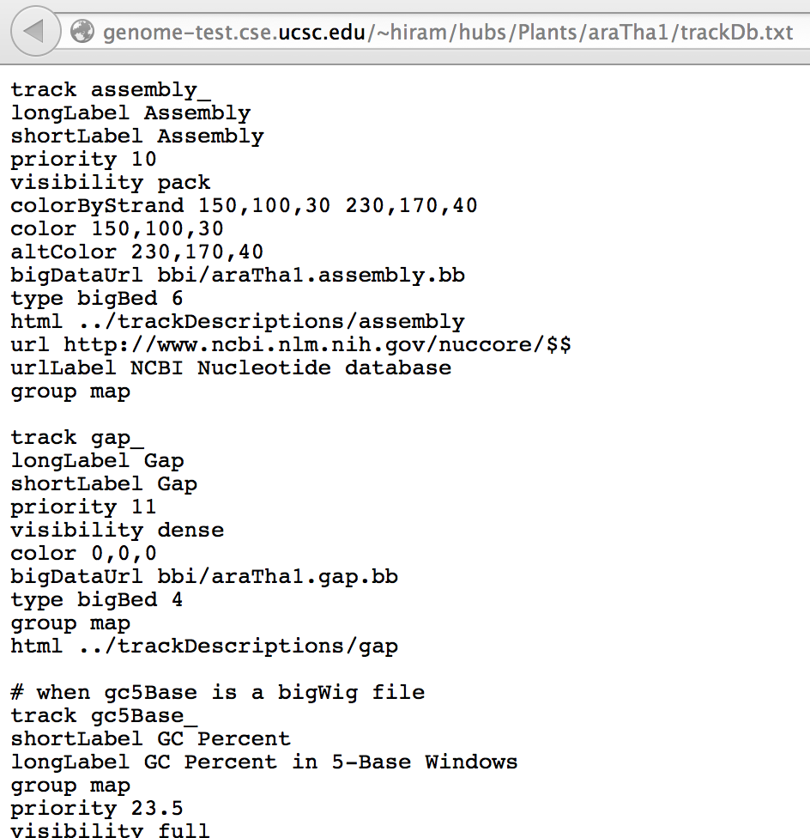
Hub file relationships, e.g. hub.txt -> genomes.txt
Notes:
The hub.txt file specifies a genomes.txt file. This is a relative URL reference to genomes.txt from the hub.txt URL. The same is true for the references to the trackDb.txt file, the bigDataUrl files, the html description pages.

Slide 11
genome to genome alignments
Partition genomes
a. 20 to 40 million bases target genome, 10,000 overlap
b. 10 to 20 million bases query genome
limit number of sequences in one chunk to ~100 to 400
thus: ~250 target pieces, ~400 query pieces, cluster jobs:
~100,000 = 250 * 400
2. run lastz on each query chunk to each target chunk
www.bx.psu.edu/~rsharris/lastz/
results in psl file format. A couple of hours to perhaps
two weeks of cluster time.
Notes:
3,000,000,000 base genome in 30,000,000 sized chunsks == 100 pieces. However, there are also many many tiny sequences that even when grouped together do not sum up to 30,000,000 bases. Thus, the number of individual sequences are limited in a single chunk of sequence to avoid excessive run time during lastz alignment. Lastz requires a variety of arguments depending upon the phylogenetic distance between the two species in question.

Slide 12
‘chain’ psl alignments
3. run axtChain on all psl files for each chromosome:
zcat ../../pslParts/$1*.psl.gz \
| axtChain -psl -verbose=0 \
-scoreScheme=human_chimp.v2.q \
-minScore=3000 -linearGap=medium stdin \
panPan2.2bit gorGor4.2bit stdout \
| chainAntiRepeat panPan2.2bit gorGor4.2bit stdin $2
www.pnas.org/content/100/20/11484.abstract
Notes:
Please read Jim Kent’s original paper from September 2003 for a discussion of the chain/net processing.

Slide 13
construct ‘nets’ from chains
# Make nets ("noClass", i.e. without rmsk/class stats which are added later):
chainPreNet panPan2.gorGor4. panPan2.chrom.sizes \
gorGor4.chrom.sizes stdout \
| chainNet stdin -minSpace=1 panPan2.chrom.sizes \
gorGor4.chrom.sizes stdout /dev/null \
| netSyntenic stdin noClass.net
# Make liftOver chains:
netChainSubset -verbose=0 noClass.net \
panPan2.gorGor4.all.chain.gz stdout \
| chainStitchId stdin stdout \
| gzip -c > panPan2.gorGor4.over.chain.gz
www.pnas.org/content/100/20/11484.abstract
Notes:
chainPreNet removes chains that do not have a chance of being netted. The chainNet constructs the hierarchy of ‘netted’ chains. The netSyntenic adds information about synteny of the chains used in the resulting ‘net’. The netChainSubset reduces the verbose ‘all.chain.gz’ set to a concise set to allow mapping from one genome to the other. The chainStitchId combinesthe resulting chain fragments from netChainSubset with the same chain ID into a single chain per ID.

Slide 14
loading chain/net tracks
# Load chains:
hgLoadChain -tIndex panPan2 chainGorGor4 panPan2.gorGor4.all.chain.gz
# Add gap/repeat stats to the net file using database tables:
netClass -verbose=0 -noAr noClass.net panPan2 gorGor4 panPan2.gorGor4.net
# Load nets:
netFilter -minGap=10 panPan2.gorGor4.net \
| hgLoadNet -verbose=0 panPan2 netGorGor4 stdin
# Measure genome to genome ‘coverage’
featureBits panPan2 chainGorGor4Link
www.pnas.org/content/100/20/11484.abstract
Notes:
The hgLoad commands merely translate text files into MySQL table data. The ‘netClass’ adds repeat classification information to the net file. The netFilter restricts the loaded net MySQL database tale to nets with gaps over the given size of 10. The featureBits measures the amount of the target genome that are covered by all of the chain ‘links’. The ‘links’ are the individual bits of alignment in a chain. This is a rough measurement of how ‘similar’ the target and query genomes are.

