Slide 1
VGP assembly resources in the UCSC Genome Browser
Gateway page: https://hgdownload.soe.ucsc.edu/hubs/VGP/
Each index is a set of three pages: Hub Access, Assembly Statistics, Track Statistics
Currently: 93 primary assemblies, 71 alternate/haplotypes, 17 trios, 29 legacy
The VGP assemblies are a subset of all assembly hubs at:
https://hgdownload.soe.ucsc.edu/hubs/
Mostly RefSeq assemblies, a few GenBank, currently: 31 primates, 133 mammals,
110 fish, 80 birds, 42 other vertebrates, 132 plants, 239 invertebrates, 355 fungi
future plans for archaea, virus, bacteria == all RefSeq assemblies, over 220,000 assemblies
URL to make an assembly appear in the browser for a given assembly identifier:
https://genome.ucsc.edu/h/GCF_009762305.2
VGP meeting 21 May 2021 – Hiram Clawson – U.C. Santa Cruz Genomics Institute

Slide 2
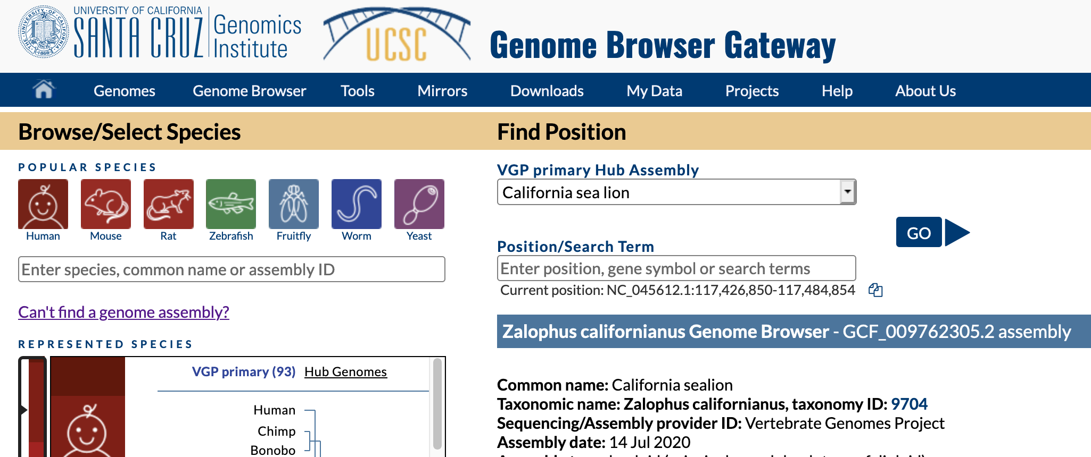
Find a genome assembly via the browser gateway page:
Enter a search word:

Slide 3
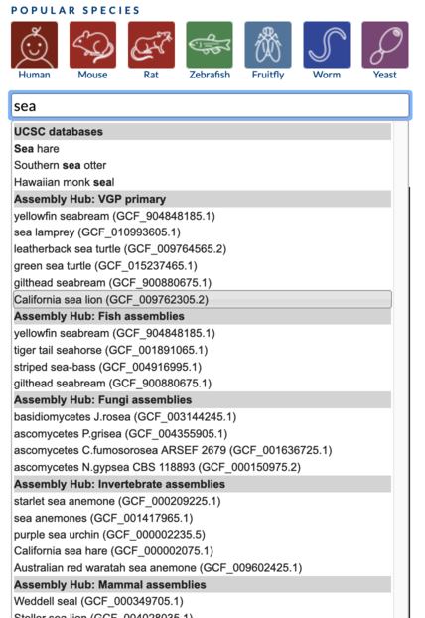
Menu of assembly choices will appear, select one to view in browser:
Enter a search word:

Slide 4
Blat tool: pull down the “Tools” menu, select blat

Slide 5
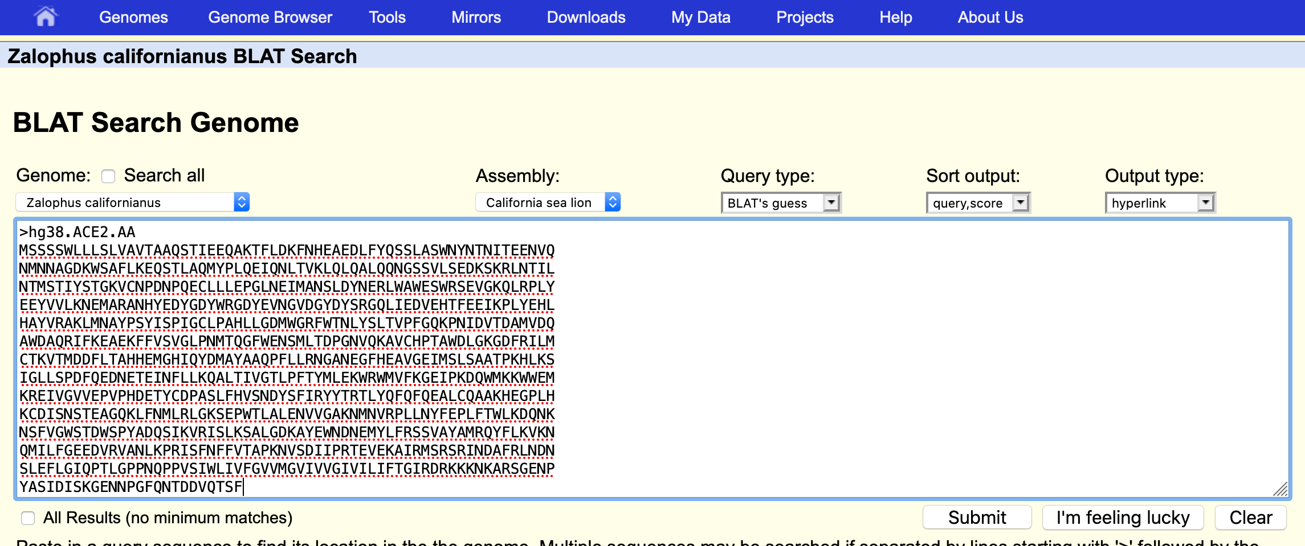
An example protein blat:

Slide 6
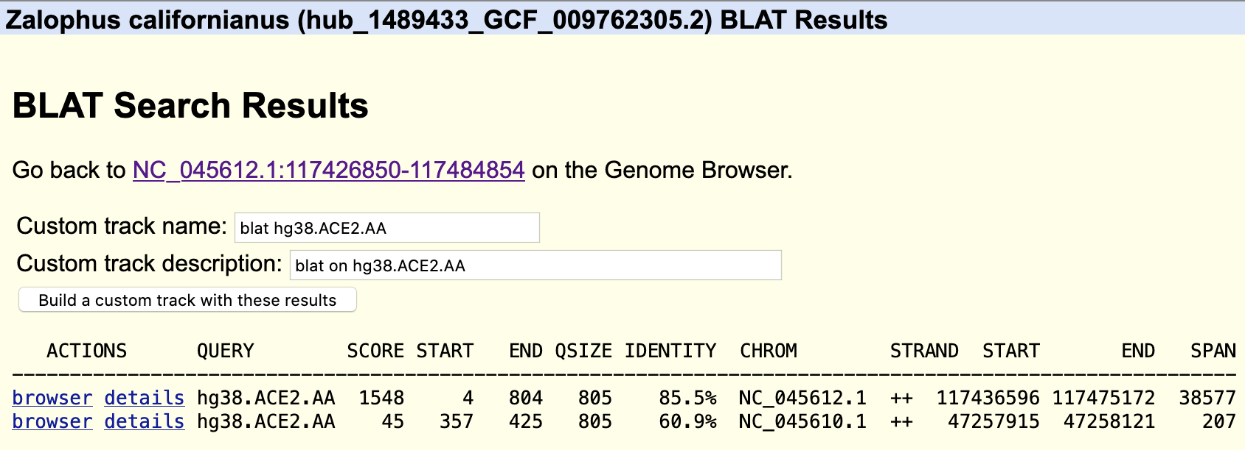
To make your blat results persistent, build a custom track from the result:

Slide 7
These dynamic blat servers can be used from the command line.
Command line blat from your desktop using ‘kent’ command: ‘gfClient’
#!/bin/bash
### given an assembly ID:
export asmId="GCF_009762305.2"
### California sea lion, Zalophus californianus,
### GCF_009762305.2_mZalCal1.pri.v2
### extract the path name elements from the assembly ID:
export gcX="${asmId:0:3}" # substring, first three characters GCF
export d0="${asmId:4:3}"
export d1="${asmId:7:3}"
export d2="${asmId:10:3}"
### this determines the path name to assembly hub directory
export hubPath="$gcX/$d0/$d1/$d2/$asmId"
### need to have the asmId.2bit file in this working directory
### for the gfClient command to function.
### The 2bit file can be obtained from the assembly hub:
rsync -a -P rsync://hgdownload.soe.ucsc.edu/hubs/$hubPath/$asmId.2bit ./

Slide 8
Continued, page 2 of 2:
YES ! This service could be overloaded. Use it politely.
It will stop responding when
overloaded. You can use the ‘blat’ command locally.
printf "# protein blat local file ACE2.AA.faa to $hubPath\n"
head -3 ACE2.AA.faa
### >hg38.ACE2.AA
### MSSSSWLLLSLVAVTAAQSTIEEQAKTFLDKFNHEAEDLFYQSSLASWNYNTNITEENVQ
### NMNNAGDKWSAFLKEQSTLAQMYPLQEIQNLTVKLQLQALQQNGSSVLSEDKSKRLNTIL
gfClient -genome=${asmId} -genomeDataDir=$hubPath \
-t=dnax q=prot dynablat-01 4040 . ACE2.AA.faa $asmId.ace2.AA.psl
### Output is in GCF_009762305.2.ace2.AA.psl
printf "# mRNA blat local file ACE2.mRNA.faa to $hubPath\n"
head -3 ACE2.mRNA.fa
### >hg38.ACE2.mRNA
### GTGTTTGTCTTGACTGGCTAGCAACTTAGAACTTTTTAAAAGAGGCAAAGGCAGAGGAGA
### ACAAAGGAAGGAGGAAGTAACTTGTGGAATGTTGAGAAAGCGCCCAACCCAAGTTCAAAG
gfClient -genome=${asmId} -genomeDataDir=$hubPath \
-t=dna q=dna dynablat-01 4040 . ACE2.mRNA.fa $asmId.ace2.mRNA.psl
### Output is in GCF_009762305.2.ace2.mRNA.psl

