Slide 1
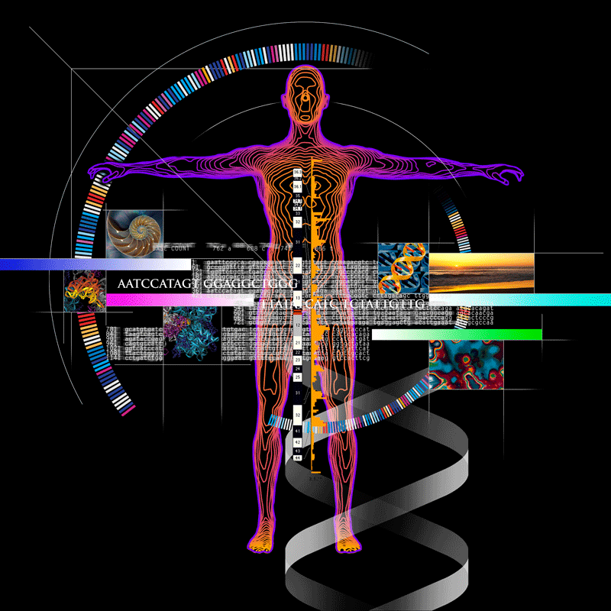
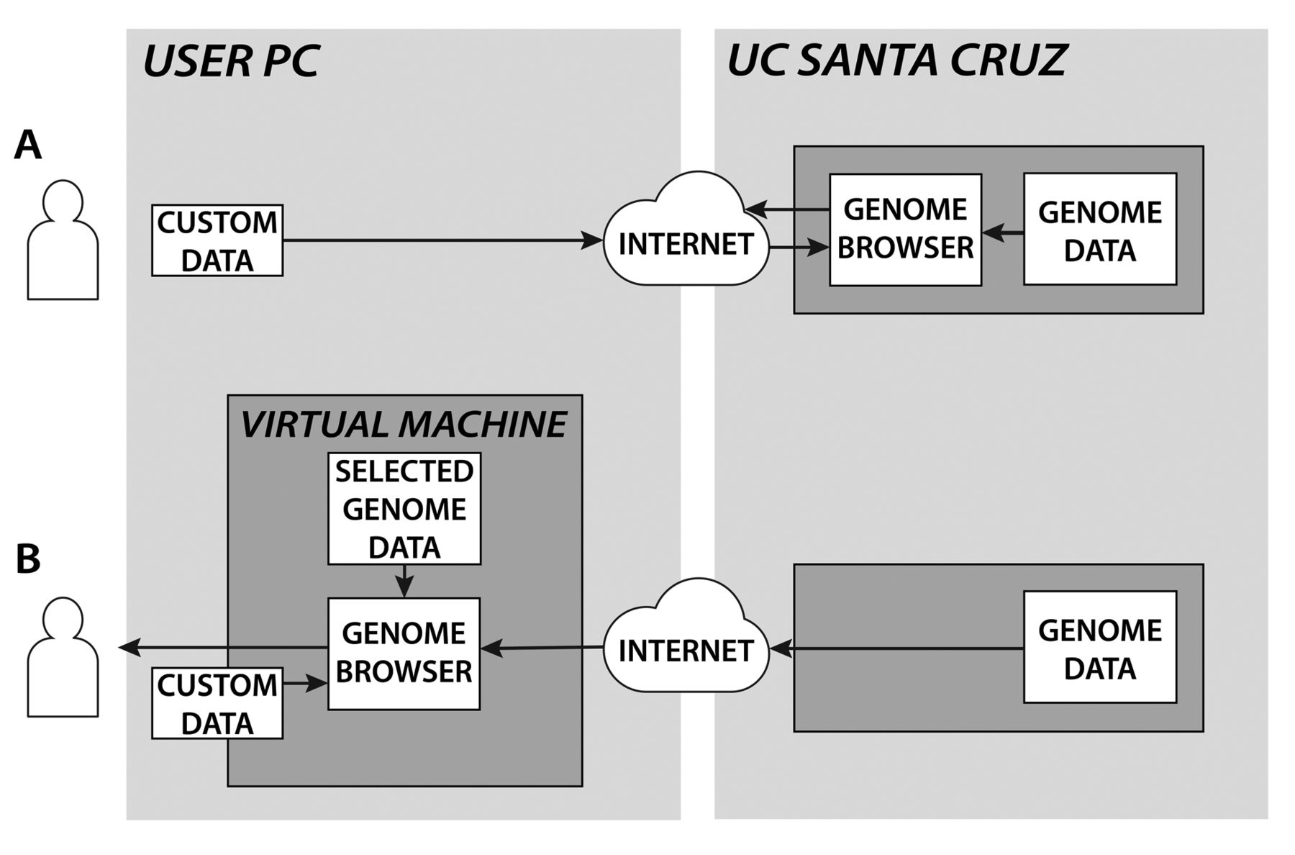
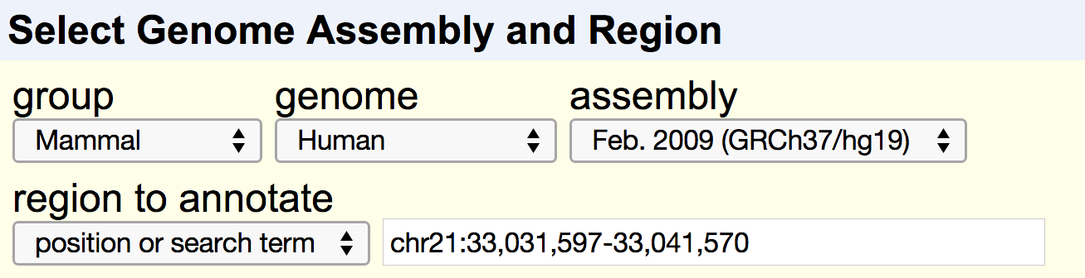
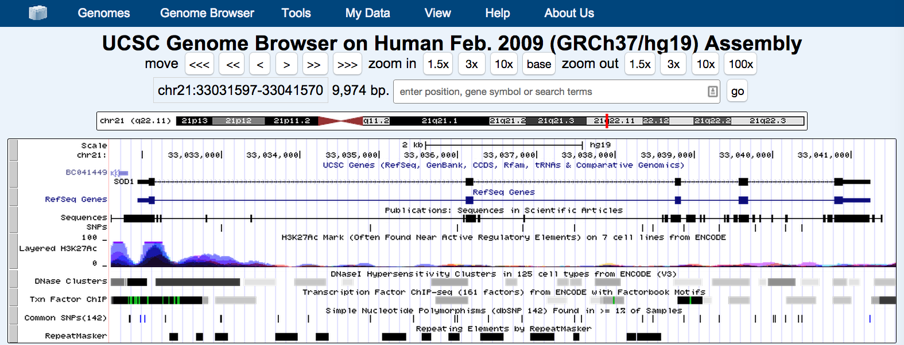
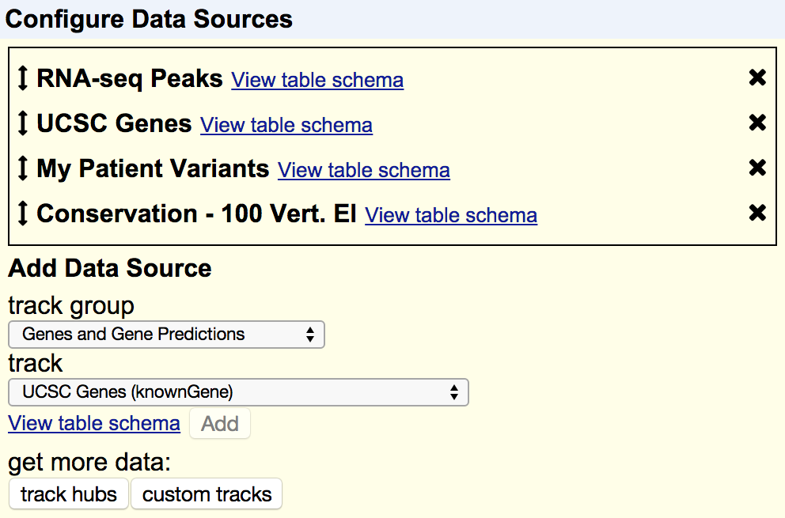
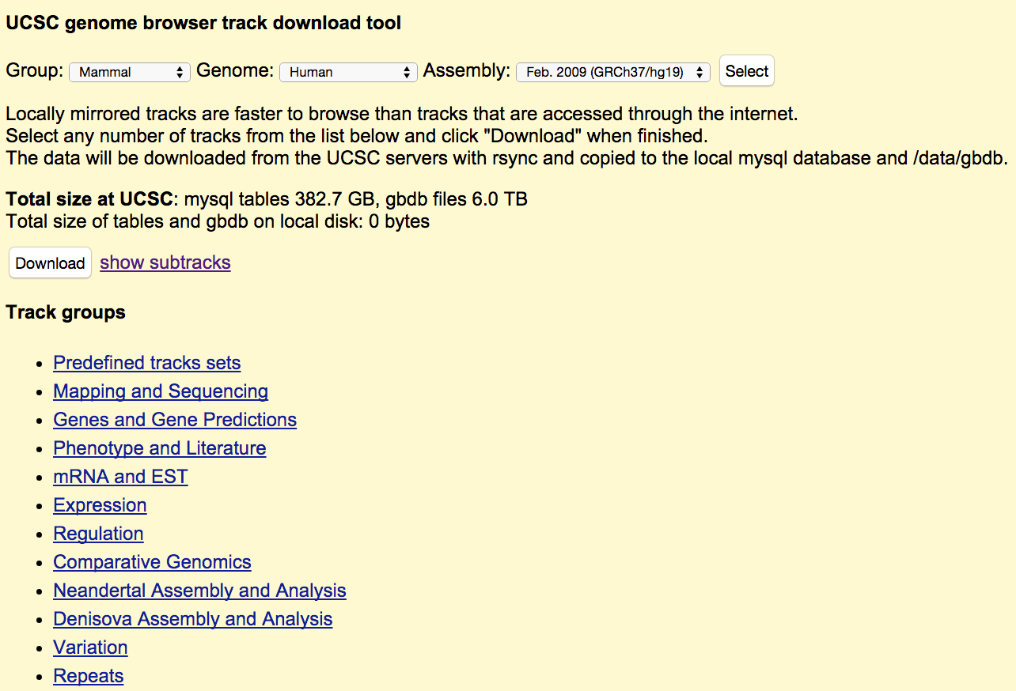
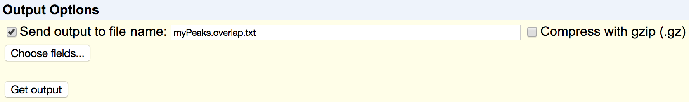
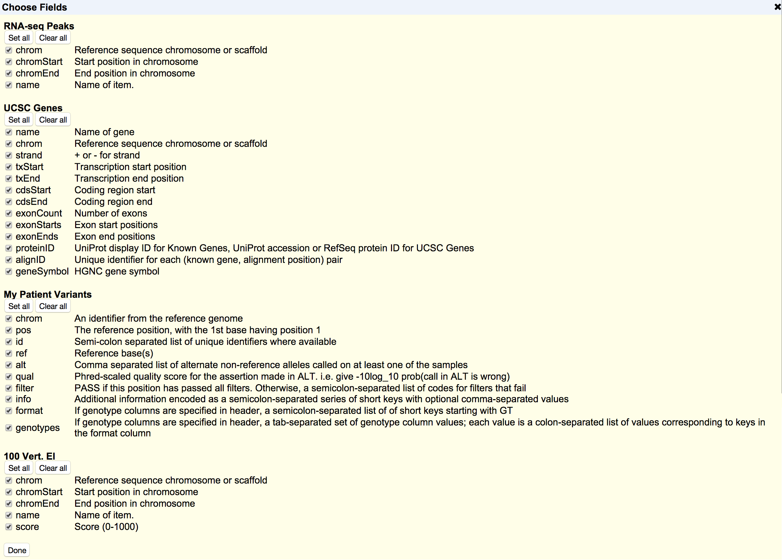


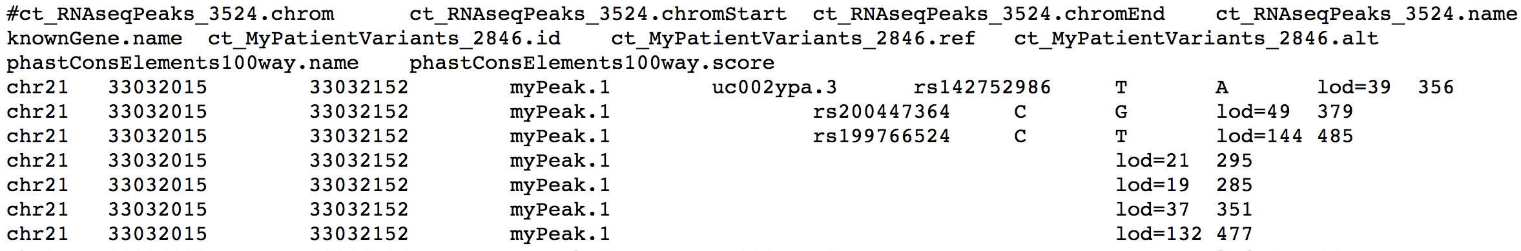

Use The UCSC Genome Browser To Visualize And Analyze Your Genomic Data
Matthew L. Speir¹, Angie S. Hinrichs¹, Maximilian Haeussler¹, Brian J. Raney¹, Hiram Clawson¹, Kate R. Rosenbloom¹, Galt P. Barber¹,
Jonathan Casper¹, Steve Heitner¹, Luvina Guruvadoo¹, Pauline A. Fujita¹, Brian T. Lee¹, Ann S. Zweig¹, Donna Karolchik¹,
Robert M. Kuhn¹, David Haussler^{1,2}, W. James Kent¹
¹ University of California Santa Cruz Genomics Institute, Santa Cruz, CA; ²Howard Hughes Medical Institute, UCSC, Santa Cruz, CA
Introduction
The UCSC Genome Browser (http://genome.ucsc.edu) is a free, web-based tool that integrates and displays genomic data from a wide variety of sources, including GenBank, ENCODE, UCSC and many others. We provide several tools to help users upload their own data and view it alongside this genomic information or export the data for analysis with other applications. Large genomic data sets and custom genome assemblies can be uploaded and displayed using the browser’s data hub tools. If you need to view private data, such as protected patient data from a clinical trial, Genome Browser in a Box (GBiB) allows you to run your own private copy of the Genome Browser on your own computer. The new Data Integrator tool lets you quickly combine input from up to five genome-wide data sets, including your own data uploaded through custom tracks or track hubs, and then export a customized output set based on intersections with a primary track. We are continually working to extend our toolset to allow users to explore their data in new and unique ways.
The UCSC Genome Browser allows you to view your annotations alongside those from a variety of sources, including ENCODE, dbSNP, ClinVar, Ensembl and many others. Here, we can see a combination of custom tracks, including a VCF file of patient SNPs, alongside UCSC gene annotations and ENCODE RNA-seq data.
Load Your Data Into
The Genome Browser Using Data Hubs
Use The Genome Browser In A Box To View Your Private Data
Tracks hubs - package and upload any number of tracks for existing assemblies.
Assembly hubs - upload a custom assembly and related annotations to view in the Genome Browser.
Both support bigBed, bigWig, bigGenePred, BAM, VCF, and HAL formats.
Find more information and examples at:
http://genome.ucsc.edu/goldenPath/help/hgTrackHubHelp.html
Use The Data Integrator To Intersect
Multiple Data Sets At Once
The Data integrator allows you to quickly and effective combine data from multiple sources. For instance, you could use it to find the genes, variants and conserved genomic regions that overlap with peaks from a recent RNA-seq experiment. Here’s how you can build a query to get that data:
Start by choosing your assembly from one of the hundreds hosted by UCSC, or upload your own with an assembly hub.
Image Credit: Casey Callow
GBiB is a virtual machine that runs on your computer. It supports custom tracks and data hubs. Any personal data loaded into GBiB never leaves your computer.
The hgMirror tool allows for easy downloading of genomic data for quicker access.
Runs on Windows, Mac, or Linux. Download is 7GB, which expands to 20GB.
Get it today!
Download GBiB from Genome Browser Store: https://genome-store.ucsc.edu/
Download and install VirtualBox: https://www.virtualbox.org/
Unzip GBiB file and load it into VirtualBox
For more information on using GBiB, see:
http://genome.ucsc.edu/goldenPath/help/gbib.html
Next, choose a region to query. This can be a single or set of regions, genome-wide, or a position found by search term.
Choose up to four tracks to intersect with a primary track.
Tracks can be ones UCSC provides or ones uploaded using custom tracks or track hubs.
More information:
Send us a message on our public mailing list:
genome@soe.ucsc.edu
View training info, videos, and user’s guides:
http://genome.ucsc.edu/training/
Find us on:
GenomeBrowser
@GenomeBrowser
UCSC Genome Browser
Lastly, configure your output.
View your output in your web browser or save it to a file, optionally compressed with gzip.
By default, all fields from selected tracks are output. Click “Choose fields” to customize the fields in your output.
Acknowledgements:
This work is funded by the National Human Genome Research Institute (5 U41 HG002371 to UCSC Center for Genomic Science). We would like to acknowledge the work of the UCSC Genome Bioinformatics technical staff (http://genome.ucsc.edu/staff.html), our many collaborators and our users for their feedback and support.
Reference:
The UCSC Genome Browser database: 2015 update. Rosenbloom KR, Armstrong J, Barber GP, Casper J, Clawson H, Diekhans M, Dreszer TR, Fujita PA, Guruvadoo L, Haeussler M, Harte RA, Heitner S, Hickey G, Hinrichs AS, Hubley R, Karolchik D, Learned K, Lee BT, Li CH, Miga KH, Nguyen N, Paten B, Raney BJ, Smit AF, Speir ML, Zweig AS, Haussler D, Kuhn RM, Kent WJ. Nucleic Acids Res. 2015 Jan;43(Database issue):D670-81.
Navigating protected genomics data with UCSC Genome Browser in a Box. Haeussler M, Raney BJ, Hinrichs AS, Clawson H, Zweig AS, Karolchik D, Casper J, Speir ML, Haussler D, Kent WJ. Bioinformatics. 2015 Mar 1;31(5):764-6.
For more information on using the Data Integrator, see:
http://genome.ucsc.edu/goldenPath/help/hgIntegratorHelp.html
View online by scanning the code or going to http://genomewiki.ucsc.edu/index.php/BioengSymp2015Poster

