Slide 1
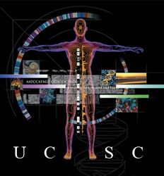
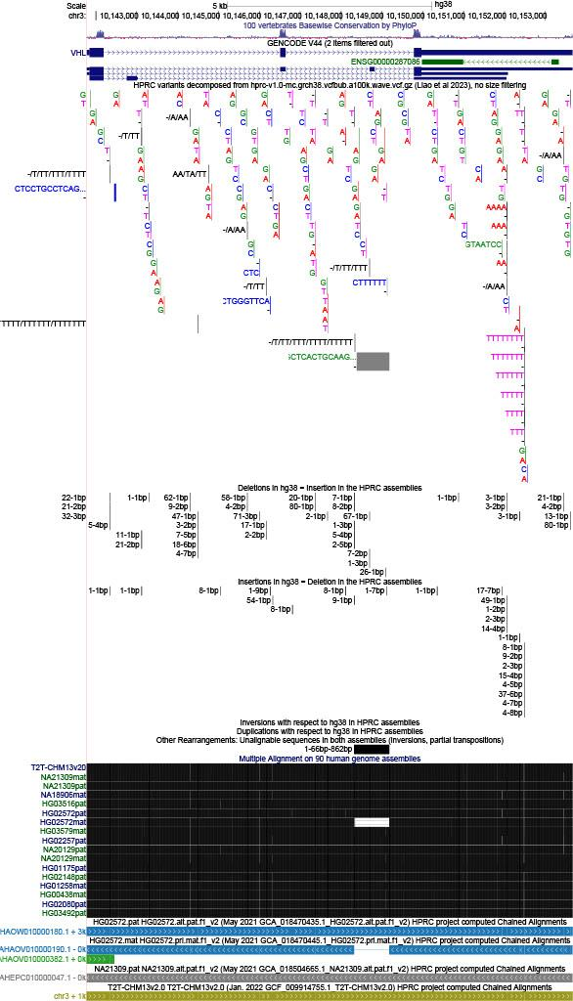
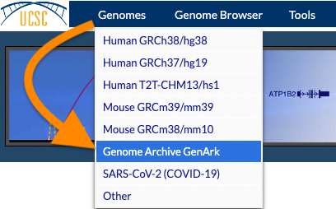
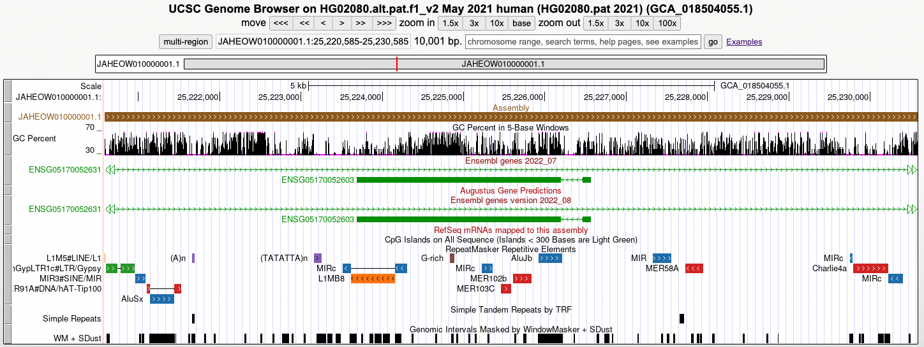
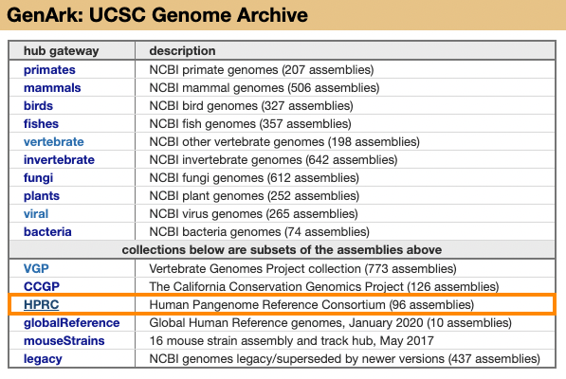
Viewing Human Pangenome Research Consortium (HPRC) data on the UCSC Genome Browser
T2T
HAPMAP
Yoruba Nigeria
Esan Nigeria
Gambian
Mende Sierra Leone
Afr Carib Barabdos
African SW USA
Puerto Rico
Peru Lima
Columbia Medellin
Han SoChina
Vietnam Kinh
Punjabo Pakis
Jairo Navarro Gonzalez, Galt Barber, Jonathan Casper, Hiram Clawson, Angie Hinrichs, Chris Lee, Luis Nassar, Gerardo Perez, Brian Raney, David Haussler, Jim Kent, Max Haeussler
References
1
2
3
4
The UCSC Genome Browser database: 2024 update. Raney BJ, Barber GP, Benet-Pagès A, Casper J, Clawson H, Cline MS, Diekhans M, Fischer C, Navarro Gonzalez J, Hickey G et al. Nucleic Acids Res. 2024 Jan 5;52(D1):D1082-D1088. DOI: 10.1093/nar/gkad987; PMID: 37953330; PMC: PMC10767968.
The Human pangenome contains 47 phased, diploid assemblies from a group of genetically diverse individuals. A total of 176 maternal and paternal haplotypes were used in this analysis. The haplotypes can be grouped into the 14 subpopulations:
4
GenArk: towards a million UCSC genome browsers. Clawson H, Lee BT, Raney BJ, Barber GP, Casper J, Diekhans M, Fischer C, Gonzalez JN, Hinrichs AS,
Lee CM et al. Genome Biol. 2023 Oct 2;24(1):217.
DOI: 10.1186/s13059-023-03057-x; PMID: 37784172; PMC: PMC10544498.
Telomere-toTelomere (T2T)
African Caribbean, Barbados
Gambian, Western Division
Yoruba, Nigeria
Esan, Nigeria
Peruvian, Lima
Colombians, Medellin
International HapMap Project
African, South West USA
Puerto Ricans, Puerto Rico
Punjabi Pakis
Mende, Sierra Leone
Southern Han Chinese
Kinh Vietnamese
HPRC data can be viewed directly on hg38
A draft human pangenome reference. Liao WW, Asri M, Ebler J, Doerr D, Haukness M, Hickey G, Lu S, Lucas JK, Monlong J, Abel HJ et al. Nature. 2023 May;617(7960):312-324.
DOI: 10.1038/s41586-023-05896-x; PMID: 37165242; PMC: PMC10172123.
All Pangenomes are Available on GenArk
With the rapid increase in genomic assemblies available, the UCSC Genome Browser has imported many NCBI assemblies via the track hub system. The UCSC Genome Browser’s GenArk hub includes all 96 HPRC pangenome assemblies.
3
Acknowledgements
This work was funded by NHGRI award 2U24HG002371 to the UCSC Genomics Institute. We would like to acknowledge the work of the UCSC Genome Browser technical staff (https://genome.ucsc.edu/staff.html), our many collaborators, and our users for their feedback and support.
More Information
Have questions?
Send us a question on our public mailing list:
genome@soe.ucsc.edu
Genome Browser tutorials and videos:
https://genome.ucsc.edu/training/index.html
Digital copy of this poster available at: https://bit.ly/BoG_2024
1
Links to view the pangenome and other NCBI resources are available
CSHL Biology of Genomes May 7th - 11th, 2024
2
Notes:
Human genetic diversity cannot be accurately represented by a single reference genome such as hg19 or hg38. The Human Pan-Genome Reference Consortium (HPRC) aims to address this by sequencing thousands of high-quality human genomes and developing tools to enhance their utility. The initial data release from the HPRC project includes 47 phased, diploid assemblies, achieving over 99% accuracy at both structural and base pair levels. Alignments of these genomes to hg38 were obtained from HPRC analysis groups, and new Genome Browser annotation tracks have been created to visualize discrepancies between hg38 and the 94 new pan-genome assemblies.
Four new tracks dedicated to the NIH's Human Pangenome Reference Consortium (HPRC) data are now available on the hg38 genome: Short Variants, Rearrangements, Chain/Nets, and 90-way multiple alignments.
https://genome.ucsc.edu/s/jnavarr5/BiologyOfGenomes2024_VHL
https://genome.ucsc.edu/s/jnavarr5/BiologyOfGenomes2024_VHL_v2
https://genome.ucsc.edu/s/jnavarr5/BiologyOfGenomes2024_VHL_v3
https://genome.ucsc.edu/s/jnavarr5/BiologyOfGenomes2024_VHL_v4

